Slide 1

News Consumption in the UK: 2021
Produced by: Jigsaw Research
Fieldwork dates: November & December 2020 and February & March 2021
Published: 27 July 2021

Slide 2
Contents
Slide | Section
5 | 1. Overall summary of findings
12 | 2. Platforms used for news nowadays
22 | 3. Cross-platform news consumption
26 | 4. News consumption via television
32 | 5. News consumption via radio
35 | 6. News consumption via newspapers
41 | 7. News consumption via social media
54 | 8. News consumption via websites or apps
63 | 9. News consumption via magazines
66 | 10. Multi-sourcing
70 | 11. Importance of sources and attitudes towards news
85 | 12. Local news
87 | 13. News consumption in the nations
99 | 14. Current affairs
101 | 15. How children aged 12-15 consume news
119 | 16. Appendix – industry currencies and methodology

Slide 3
Introduction
This report provides the findings of Ofcom’s 2020/21 research into news consumption across television, radio, print, social media, podcasts, other websites/apps and magazines. It is published as part of our range of market research reports examining the consumption of content, and attitudes towards that content, across different platforms.
The aim of this slide pack report is to inform understanding of news consumption across the UK and within each UK Nation. This includes sources and platforms used, the perceived importance of different outlets for news, attitudes towards individual news sources, international and local news use.
This slide pack also provides an understanding of current affairs consumption among adults and news consumption among 12-15 year olds.
The primary source for this report is Ofcom’s News Consumption Survey. The report also contains information from BARB for television viewing.

Slide 4
Methodology and sample
Due to Covid-19 enforced methodological changes, the adults’ data in this report is not comparable to data in the previous News Consumption Reports
In News Reports published from 2018 to 2020, the adult (16+) research was conducted using a mixed methodology, combining online and face to face interviews (F2F). However, during the most recent period of research, due to Covid-19 fieldwork restrictions, it was not possible to conduct F2F interviews. In order to continue representing no/low internet users the F2F interviews were replaced by telephone (CATI) interviews.
Due to differences in the questionnaire and differences in how respondents answered questions about individual news sources between the two survey methods used, only platform level data is available by the combined methodology adult sample. All other adults’ slides are based on the online sample only.
Reweighted adults’ online sample only data from 2020 has included in this report to allow an element of trend analysis. As a result, 2020 data shown in this report may differ from the 2020 data published in last year's report. Please note, 2020 fieldwork took place before the Covid-19 pandemic in the UK.
The children’s (12-15) survey methodology was unchanged (online) and therefore that data remains comparable to previous reports.
Fieldwork for the adults’ survey this year took place from 2nd November – 10th December 2020 and 27th February – 29th March 2021. Fieldwork for the children's survey this year took place from 24th November – 7th December 2020 and 27th February – 24th March 2021. These fieldwork periods overlapped with the second and third phases of UK lockdown.

Slide 5
Overall summary of findings

Slide 6
Summary of key findings (1)
TV is the most-used platform for news (79%), followed by the internet (73%), with half of adults using social media (49%) and/or other websites/apps (49%) for news. However, fewer than half now use the radio for news (46%) and less than a third use print newspapers (32%). Use of TV is most prevalent among the 65+ age group (93%), while the internet is the most-used platform for news consumption among 16-24s (89%) and those from minority ethnic groups (85%) ​
The online trend data shows that usage of radio, print newspapers and the internet for news have all declined since 2020 (-6, -5 and -3 percentage points respectively). Use of TV is unchanged
BBC One remains the most-used news source across any platform (62%), followed by ITV (46%) and Facebook (36%), then the BBC website/app (31%), the BBC News channel (31%) and Sky News Channel (30%).
Usage of BBC One has remained unchanged since 2020, but usage of ITV and Facebook have both decreased.
Usage of Channel 4, BBC Radio 2 and BBC Radio 1 have also decreased over the last year
When rated by their users on measures such as importance, trustworthiness, range of opinions and impartiality, the main news platforms’ ratings are largely in line with 2020; TV and magazines performing strongest, and social media performing least well
TV remains the most common platform for accessing local news and news within the Nations. BBC One is the most used news source in England and Wales for accessing news about the Nation, whereas STV is most used in Scotland and UTV and BBC One are most used in Northern Ireland

Slide 7
Summary of key findings (2)
As in previous years, just under six in ten (57%) 12-15 year olds are interested in news. These children primarily engage with news to understand what’s going on around them, to learn about new things and to be made to think. Being 'too boring' remains the key reason for lack of interest in news, followed by ‘all news sounding the same’ and a ‘lack of relevance’
12-15 year olds remain particularly interested in news about music (53%), followed by news about celebrities (45%), the environment (44%) and serious things happening in the UK (43%). However, one in five are ‘most’ interested in news about sport/sports personalities
Talking to family (68%) and watching TV (65%) are the most common ways to find out about news among 12-15 year olds, followed by social media (57%) and talking to friends (53%). BBC One/BBC Two remain the most-used (35%) and most important news sources (14%). However there has been a significant reduction in the use of BBC One/BBC Two and ITV in the last year. In contrast, Sky News, TikTok and WhatsApp are all used more often than in 2020
Family, radio, then podcasts and TV are considered to be the most truthful news sources among 12-15 year olds. Social media and friends are still considered the least truthful sources

Slide 8
Overall summary – Adults (1)
TV remains the most-used platform among UK adults (16+) for news (79%), followed by the internet (73%), radio (46%) and print newspapers (32%). Trend data among the online sample only shows that use of radio, newspapers and the internet for news have all declined since 2020, while usage of TV is unchanged. TV sources represent seven of the top 20 most-used news sources - the most of any platform (the top 20 news sources also include four social media sites, three newspaper titles (print or digital format), three radio stations and three websites/apps). While TV is the most-used platform for news overall, there are some exceptions; for example, 16-24s are still more likely to use the internet for news than TV (89% vs. 61%), while the same is true for those from minority ethnic groups (85% vs. 69%).
BBC One remains the most-used news source across all platforms, with 62% reach among all online UK adults, followed by ITV and Facebook. Several sources in the top 20 have seen decreases in use since 2020: ITV/ITV WALES/UTV/STV (46%), Facebook (36%), Channel 4 (24%), BBC Radio 2 (13%) and BBC Radio 1 (11%). BBC sources represent seven of the top 20 most-used news sources. Furthermore, when sources are grouped by organisation, the BBC has the highest audience reach (83%), followed by ITV (50%), Sky (36%) and DMGT (30%).
BBC One also remains the top single most important news source for the largest proportion (19%) of those who use the main platforms for news, although this has decreased from 22% of adults stating this in 2020. The BBC website/app was selected as the most important news source by 11% of news users, an increase from 2020. This is followed by ITV (7%, a decline from 2020), Facebook (6%) and Sky News Channel (6%). However, this does vary by age: social media channels are more important among younger age groups, with 36% of 16-24s selecting a social media channel as their most important news source.
Around half (49%) of UK adults claim to use social media for news and 49% also say they use ‘other websites and apps’- i.e. any non-social media sources of news, such as websites and apps of news organisations, newspapers or other apps (e.g. LADbible). Around a fifth (19%) of UK adults say they use news aggregators, and 25% say they use search engines for news, a decline from 2020. The BBC website / app is most used 'other website/app’, used by 31% of UK adults, followed by Google (search engine) used by 17% of UK adults. 12% of those using social media for news use TikTok for news, an increase from 4% in 2020.

Slide 9
Overall summary – Adults (2)
In 2021, a third of users of social media for news claimed to mostly get news from social media posts, a decrease from 2020. As in 2020, news consumed on social media is more likely to be from news organisations than ‘friends/family’ or ‘others you follow’. The BBC remains the most commonly followed news organisation across the social media sites, followed by Sky News on Twitter, Instagram and YouTube, ITV on Facebook and The Sun on Snapchat.
At a platform level, attitudes towards news provision (including quality, accuracy, trustworthiness and impartiality) remain consistent with 2020, with TV and magazines performing strongest, and social media performing least well. At the individual source level attitudes also remain largely consistent with 2020. When asked which sources were good for ‘providing news about Covid-19’ and ‘helping people to understand the restrictions’ users of each platform identified TV as performing strongest and social media as performing comparatively poorly.
TV remains the most popular platform for accessing local news and people are still highly satisfied with the quality of this news. Half of online UK adults who follow news say they watch regional/local broadcasts on BBC TV and 37% watch ITV/ITV WALES/UTV/STV. Four in five of these viewers are satisfied with the quality of news these channels provide.
TV remains the most common platform for accessing news about respondents’ own nation. BBC One is the most used news source in England and Wales for accessing news about the nation, whereas STV is most used in Scotland and UTV and BBC One are most used in Northern Ireland. BBC One is the most important news source in England, Wales and Northern Ireland while BBC One and the BBC website/app are equally important in Scotland. Respondents in Northern Ireland and Scotland are most likely to say they are very interested in news about their nation (57% in Northern Ireland and 51% in Scotland vs 41% in Wales and 31% in England).
As in 2020, six in ten adults (63%) think it is important for ‘society overall’ that broadcasters provide current affairs programming, more than those who say it is important to them personally (54%).

Slide 10
Overall summary – 12-15 year olds (1)
As in 2020, just under six in ten 12-15s claim to be either ‘very’ or ‘quite’ interested in news. These children primarily engage with news to ‘understand what’s going on around them’, to ‘learn about new things’ and to ‘make them think’. Among the four in ten who are not interested in the news, the main reason is it is ‘too boring’ (47%). A further 19% said it ‘all sounds the same’, 16% said it ‘was not relevant for people their age’, and 8% said it was ‘too upsetting’.
The highest level of interest was in music news. When asked about their interest in different types of news, the highest level of interest was in music news (53%). When asked which types of news content they are ‘most’ interested in sports/sports personalities (22%) and music news/singers/musicians (15%) were the top choices.
Talking with family and watching the TV continue to be the most common ways to find out about the news. Talking to family (68%) and watching TV (65%) are the most common ways to find out about news, followed by social media (57%) and talking to friends (53%). However, TV remains the platform used most often for news (27%), followed by social media (22%) and talking to family (19%). As in 2018, 2019 and 2020 social media is used most often for celebrity, music and fashion news, while TV is used most often for all other types of news content.

Slide 11
Overall summary – 12-15 year olds (2)
BBC One/Two (35%) and YouTube (33%) are the most-used news sources for 12-15s across all platforms. However, BBC One/Two declined from 41% in 2020 and 45% in 2018. BBC One/Two remain the most important (14%) news sources. The next most used news sources are Instagram (28%) and Facebook (27%). There are seven social media sites in the top ten most used sources for 12-15s. The reach of ITV (24%) has also decreased from 28% in 2020 while Sky News, TikTok and WhatsApp have all seen increases since 2020. 12-15s remain most likely to first find out about social media sources from friends and find out about TV and radio sources from parent(s).
Family, radio, podcasts and TV are perceived as the most truthful news sources, while social media and friends are perceived to be the least truthful. Four in five (80%) 12-15s said the news they heard from family was either ‘always’ or ‘mostly’ accurate, compared to 75% for radio, 69% for podcasts and 69% for TV. Only one in three think news stories on social media (34%) or from friends (37%) are accurate.
Two fifths (41%) of 12-15s say they have seen a deliberately untrue / misleading news story online in the past 12 months. 42% of 12-15s who use social media for news claim they always/often think about whether the stories they see there are accurate. However, 52% say it is difficult to tell whether news on social media is accurate or not. The most common actions they would take if they saw a deliberately misleading story are to tell parents or another family member (37%), followed by telling friends (21%). A third (33%) said they would probably just ignore it/wouldn’t do anything.

Slide 12
Platforms used for news nowadays

Slide 13
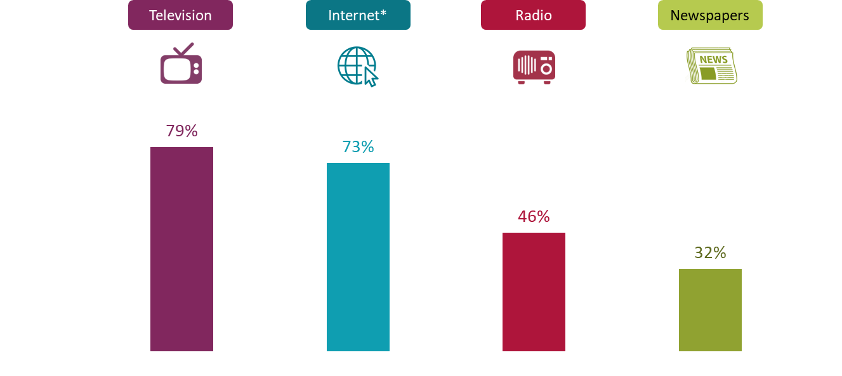
Use of main platforms for news nowadays 2021
All adults 16+
TV and Internet are the most-used platforms for news nowadays. Fewer than half use the radio and less than a third use print newspapers
Figure 2.1
Source: Ofcom News Consumption Survey 2021 – COMBINED CATI & ONLINE sample
Question: C1. Which of the following platforms do you use for news nowadays?
Base: All Adults 16+ - 2021=4605
*Internet figures include use of social media, podcasts and all other websites/apps accessed via any device
Data not comparable to previous surveys, due to Covid-19 enforced methodological changes

Slide 14
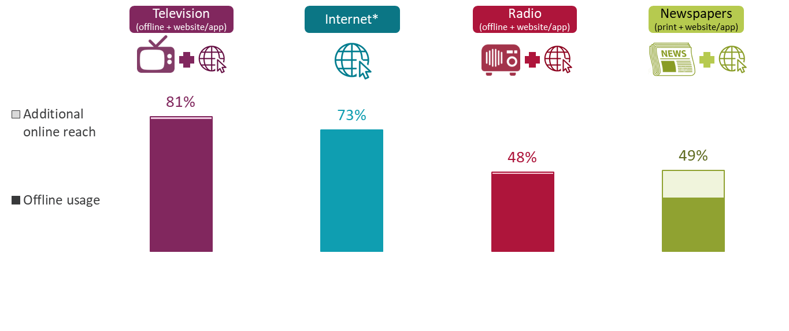
Use of main platforms for news nowadays 2021
All adults 16+
Combining use of print newspapers and newspaper websites/apps brings the overall use of newspapers up to half of adults
Figure 2.2
In the internet section of the questionnaire, we ask respondents ‘In which types of ways do you access and use news through internet sources nowadays’. A possible answer here was ‘Watch TV news online’. Including respondents who selected this option, who didn’t originally say they used TV for news, brings the total for TV news (online or offline) to 81%.
Another option here was ‘Listen to radio news online’, including those who selected this option, who hadn’t originally said they use radio for news, brings the total for radio (online or offline) to 48%.
Combining mentions of reading news in printed newspapers and via newspaper websites/apps, brings the total for newspapers (online or offline) to 49%.
Source: Ofcom News Consumption Survey 2021 – COMBINED CATI & ONLINE sample
Question: C1. Which of the following platforms do you use for news nowadays?
Base: All Adults 16+ - 2021=4605
*Internet figures include use of social media, podcasts and all other websites/apps accessed via any device
Data not comparable to previous surveys, due to Covid-19 enforced methodological changes

Slide 15
Use of main platforms for news nowadays 2021 - by demographic group
All adults 16+
16-24s and people from minority ethnic groups are more likely to use the internet for news. Those aged 65+ and white adults are more likely to use TV, radio and print, while ABC1s are more likely use the internet, radio and print
Figure 2.3
 | Total | Male | Female | 16-24 | 65+ | ABC1 | C2DE | Minority ethnic groups | White
Television | 79% | 80% | 79% | 61% | 93% | 80% | 78% | 69% | 81%
Internet (any device)* | 73% | 73% | 73% | 89% | 50% | 77% | 68% | 85% | 71%
Radio | 46% | 49% | 43% | 29% | 50% | 50% | 42% | 28% | 49%
Newspapers (print only) | 32% | 37% | 27% | 16% | 50% | 34% | 29% | 23% | 33%
Newspapers (print + website/app) | 49% | 53% | 44% | 34% | 61% | 53% | 43% | 42% | 50%
Average number of platforms | 2.3 | 2.4 | 2.2 | 1.9 | 2.4 | 2.4 | 2.2 | 2.0 | 2.3
Data not comparable to previous surveys, due to Covid-19 enforced methodological changes
Source: Ofcom News Consumption Survey 2021 – COMBINED CATI & ONLINE sample Green shading indicates significant differences between groups
Question: C1. Which of the following platforms do you use for news nowadays?
Base: All Adults 16+ 2021 - Total=4605, Male=2231, Female=2372, 16-24=839, 65+=935, ABC1=2558, C2DE=2016, Minority ethnic groups=641, White=3951
*Internet figures include use of social media, podcasts and all other websites/apps accessed via any device

Slide 16
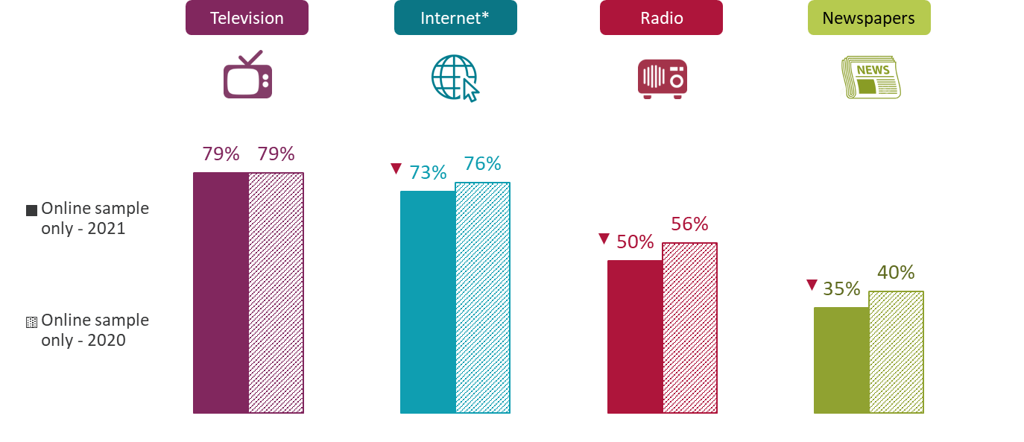
Use of main platforms for news nowadays 2021 vs 2020 – Online (only) sample comparison
All adults 16+
Use of radio, print newspapers and internet have all declined significantly since 2020, among the online sample
Figure 2.4
Source: Ofcom News Consumption Survey 2021 - ONLINE sample only
Question: C1. Which of the following platforms do you use for news nowadays?
Base: All adults 16+ – 2021=3327, 2020=2510
*Internet figures include use of social media, podcasts and all other websites/apps accessed via any device
Green/red triangles indicate statistically significant differences between 2021 and 2020
2020 and 2021 ONLINE SAMPLE ONLY

Slide 17
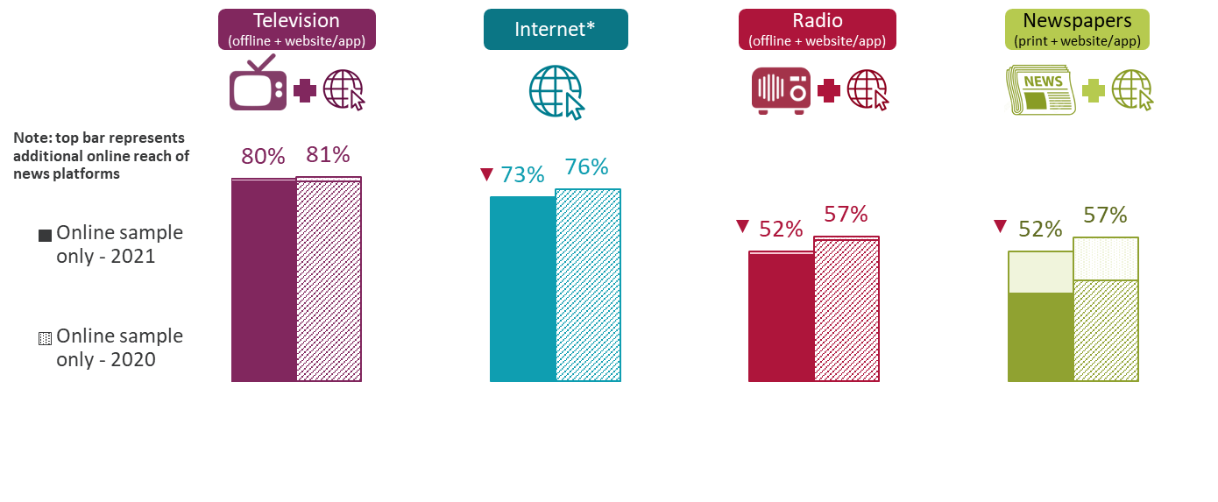
Use of main platforms for news nowadays 2021 vs 2020 – Online (only) sample comparison
All adults 16+
Use of radio and newspapers have also declined significantly when the additional online reach is included, amongst the online sample
Figure 2.5
In the internet section of the questionnaire, we ask respondents ‘In which types of ways do you access and use news through internet sources nowadays’. A possible answer here was ‘Watch TV news online’. Including respondents who selected this option, who didn’t originally say they used TV for news, brings the total for TV news (online or offline) to 80%.
Another option here was ‘Listen to radio news online’, including those who selected this option, who hadn’t originally said they use radio for news, brings the total for radio (online or offline) to 52%.
Combining mentions of reading news in printed newspapers and via newspaper websites/apps, brings the total for newspapers (online or offline) to 52%.
Source: Ofcom News Consumption Survey 2021 - ONLINE sample only
Question: C1. Which of the following platforms do you use for news nowadays?
Base: All adults 16+ – 2021=3327, 2020=2510
*Internet figures include use of social media, podcasts and all other websites/apps accessed via any device
Green/red triangles indicate statistically significant differences between 2021 and 2020
2020 and 2021 ONLINE SAMPLE ONLY

Slide 18
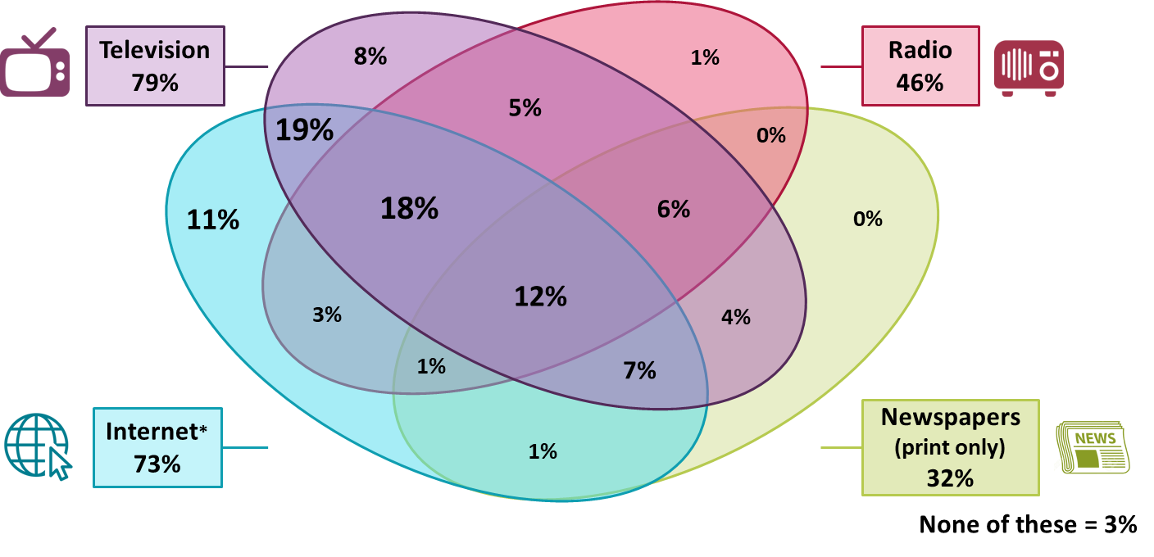
Crossover use of four main platforms for news nowadays 2021
All adults 16+
12% of adults claim to use all four of the main platforms for news nowadays
Figure 2.6
Source: Ofcom News Consumption Survey 2021 – COMBINED CATI & ONLINE sample
Question: C1. Which of the following platforms do you use for news nowadays?
Base: All Adults 16+ - 2021=4605
*Internet figures include use of social media, podcasts and all other websites/apps accessed via any device
Data not comparable to previous surveys, due to Covid-19 enforced methodological changes

Slide 19
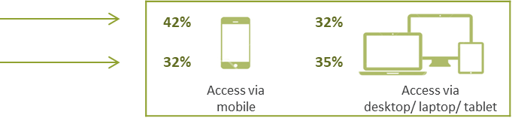
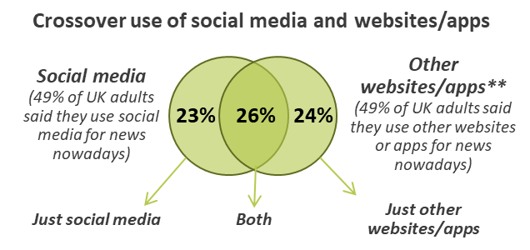
All platforms used for news nowadays 2021
All adults 16+
Social media and other websites/apps are each used for news by half of adults, while 1 in 10 claim to use podcasts
Figure 2.7
Newspapers
(print + website/app)
49% in 2021
Source: Ofcom News Consumption Survey 2021 – COMBINED CATI & ONLINE sample
Question: C1. Which of the following platforms do you use for news nowadays?
Base: All Adults 16+ - 2021=4605
*Internet figures include use of social media, podcasts and all other websites/apps accessed via any device
**Other websites/apps includes any non-social media internet source (excluding podcasts)
Data not comparable to previous surveys, due to Covid-19 enforced methodological changes

Slide 20
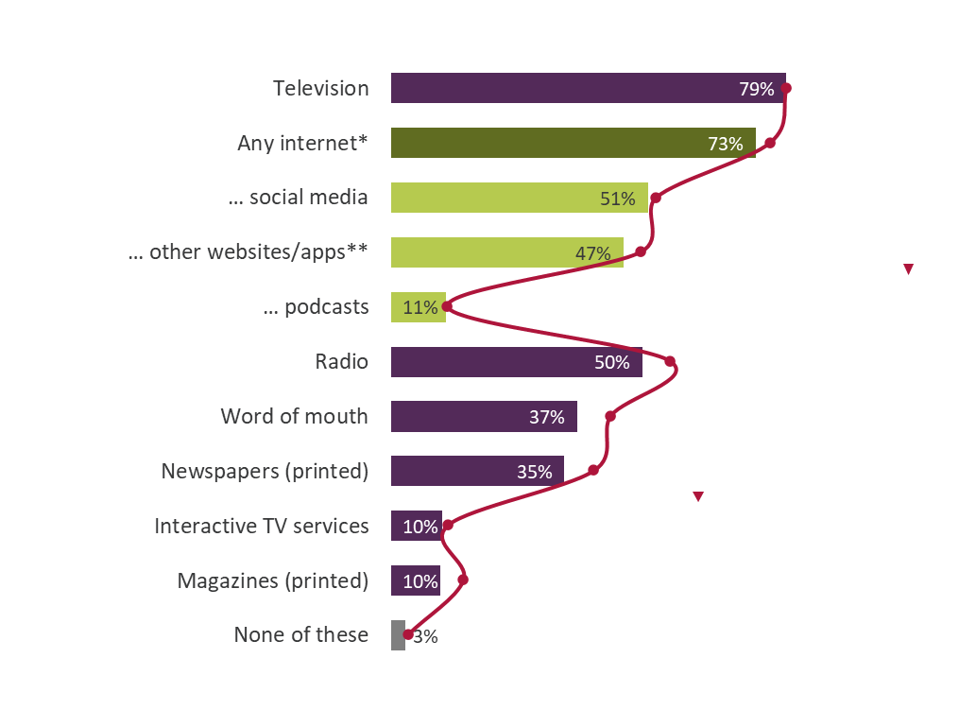
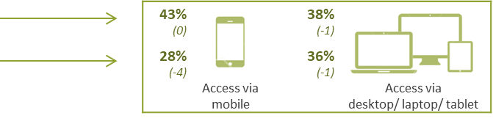

All platforms used for news nowadays
All adults 16+
In addition to radio and newspapers, usage of other websites/apps, word of mouth and magazines have also declined since 2020, amongst the online sample
Figure 2.8
Newspapers
(print + website/app)
52% in 2021
(-5 vs. 2020)
Source: Ofcom News Consumption Survey 2021 – ONLINE sample only Green/red triangles indicate statistically significant differences between 2021 and 2020
Question: C1. Which of the following platforms do you use for news nowadays?
Base: All Adults 16+ - 2021=3327, 2020=2510
*Internet figures include use of social media, podcasts and all other websites/apps accessed via any device
**Other websites/apps includes any non-social media internet source (excluding podcasts)
2020 and 2021 ONLINE SAMPLE ONLY

Slide 21
Platforms used most often for different types of news content 2021
All adults 16+ who follow news
TV is the most-used platform for almost all types of news content, except for celebrity news, where social media is used most often
Figure 2.9
Source: Ofcom News Consumption Survey 2021 – COMBINED CATI & ONLINE sample
Question: D1. Where do you tend to go most often for each of the following types of news content?
Base: All adults 16+ who follow news – 2021=4499
*Other websites/apps includes any non-social media internet source (including podcasts)
Data not comparable to previous surveys, due to Covid-19 enforced methodological changes

Slide 22
Cross-platform news consumption

Slide 23
Top 20 news sources
% of all adults 16+ using each source for news nowadays
BBC One remains the most-used news source across platforms, followed by ITV and Facebook which have both declined since 2020. Use of Channel 4, BBC Radio 2 and BBC Radio 1 has also declined since 2020
Figure 3.1
 | 2021 | 2020
BBC One | 62% | 62%
ITV/ITV WALES/UTV/STV | 46% | 49%
Facebook | 36% | 40%
BBC website/app | 31% | 32%
BBC News Channel | 31% | 30%
Sky News Channel | 30% | 28%
Channel 4 | 24% | 26%
Twitter | 24% | 24%
Daily Mail/Mail on Sunday | 22% | 23%
Instagram | 19% | 18%
Google (search engine) | 17% | 19%
BBC Two | 16% | 15%
WhatsApp | 16% | 17%
The Guardian/Observer | 16% | 16%
BBC Radio 2 | 13% | 16%
The Sun/Sun on Sunday | 12% | 14%
Sky News website/app | 12% | 11%
Channel 5 | 12% | 11%
BBC Radio 1 | 11% | 13%
BBC Radio 4 | 11% | 12%
TV channel
Newspaper (print + website/app)
Radio station
Social media
Other website/app
Source: Ofcom News Consumption Survey 2021 - ONLINE sample only
Question: D2a-D8a. Thinking specifically about <platform>, which of the following do you use for news nowadays?
Base: All adults 16+ – 2021=3327, 2020=2510
Green/red triangles indicate statistically significant differences between 2021 and 2020 online sample
2020 and 2021 ONLINE SAMPLE ONLY

Slide 24
Top 20 news sources 2021 - by demographic
% of all adults 16+ using each source for news nowadays
16-24s are more likely to use social media for news, whereas those aged 65+ are more likely to use TV (especially BBC One), Daily Mail and radio sources. ABC1s are more likely than C2DEs to use the majority of news sources
Figure 3.2
 | Total | Male | Female | 16-24 | 65+ | ABC1 | C2DE | Minority ethnic groups | White
BBC One | 62% | 63% | 61% | 46% | 82% | 65% | 59% | 50% | 64%
ITV/ITV WALES/UTV/STV | 46% | 43% | 49% | 33% | 58% | 43% | 51% | 35% | 47%
Facebook | 36% | 30% | 42% | 44% | 16% | 34% | 40% | 43% | 35%
BBC website/app | 31% | 35% | 27% | 29% | 29% | 37% | 24% | 33% | 31%
BBC News Channel | 31% | 35% | 27% | 21% | 44% | 34% | 27% | 31% | 31%
Sky News Channel | 30% | 35% | 25% | 22% | 33% | 32% | 27% | 33% | 30%
Channel 4 | 24% | 25% | 22% | 18% | 28% | 24% | 23% | 25% | 23%
Twitter | 24% | 24% | 23% | 44% | 6% | 26% | 21% | 38% | 22%
Daily Mail/on Sunday (print + website/app) | 22% | 23% | 20% | 15% | 33% | 23% | 20% | 20% | 22%
Instagram | 19% | 15% | 23% | 48% | 1% | 19% | 18% | 42% | 15%
Google (search engine) | 17% | 18% | 17% | 18% | 15% | 18% | 16% | 23% | 16%
BBC Two | 16% | 19% | 12% | 10% | 25% | 17% | 15% | 14% | 16%
WhatsApp | 16% | 15% | 17% | 25% | 4% | 16% | 16% | 38% | 13%
The Guardian/Observer (print + website/app) | 16% | 17% | 14% | 20% | 11% | 19% | 11% | 22% | 15%
BBC Radio 2 | 13% | 15% | 12% | 6% | 19% | 15% | 11% | 5% | 14%
The Sun/Sun on Sunday (print + website/app) | 12% | 14% | 11% | 11% | 11% | 10% | 16% | 14% | 12%
Sky News website/app | 12% | 14% | 10% | 10% | 7% | 13% | 11% | 14% | 12%
Channel 5 | 12% | 12% | 11% | 7% | 16% | 11% | 14% | 13% | 12%
BBC Radio 1 | 11% | 10% | 12% | 17% | 3% | 10% | 12% | 13% | 11%
BBC Radio 4 | 11% | 13% | 8% | 3% | 22% | 14% | 6% | 6% | 11%
Source: Ofcom News Consumption Survey 2021 - ONLINE sample only
Question: D2a-D8a. Thinking specifically about <platform>, which of the following do you use for news nowadays?
Base: All adults 16+ 2021 - Total=3327, Male=1602, Female=1723, 16-24=656, 65+=620, ABC1=1884, C2DE=1422, Minority ethnic groups=552, White=2762
Green shading indicates significant differences between groups

Slide 25
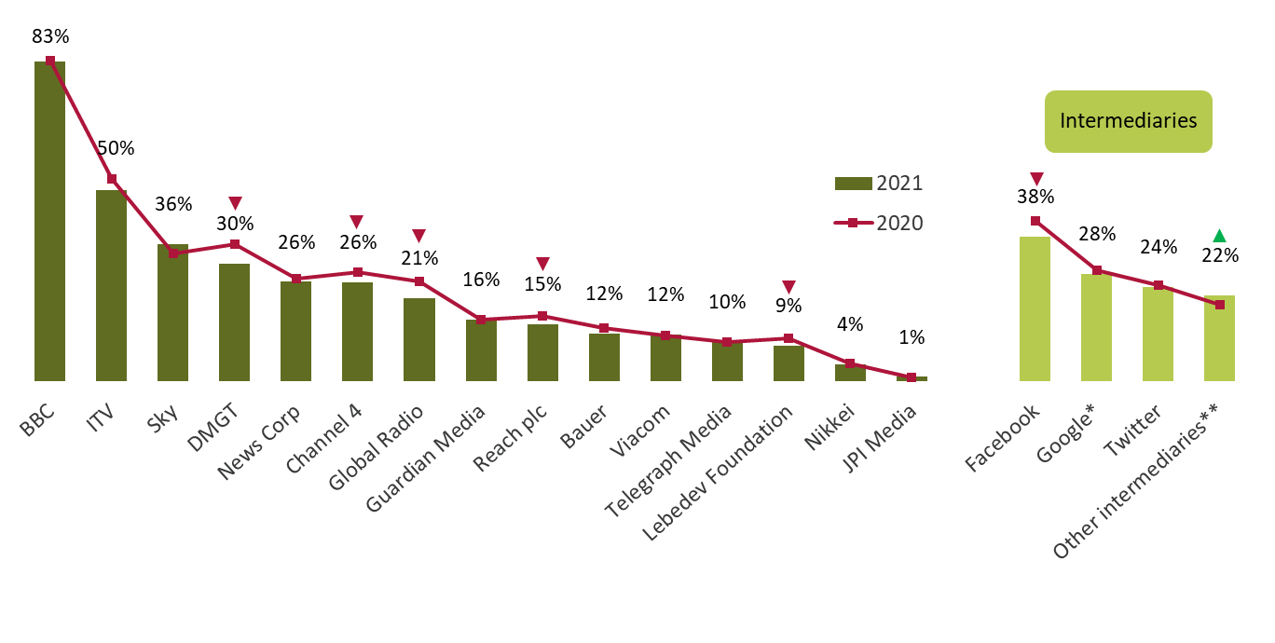
Cross-platform retail providers used for news nowadays
All adults 16+ using TV/Newspapers/Radio/Internet/Magazines for news
The reach of DMGT, Channel 4, Global Radio, Reach, Lebedev Foundation and Facebook have all declined, while ‘other intermediaries’ have increased
Figure 3.4
Source: Ofcom News Consumption Survey 2021 - ONLINE sample only Green/red triangles indicate statistically significant differences between 2021 and 2020
Question: D2a-D8a. Thinking specifically about <platform>, which of the following do you use for news nowadays?
Base: All adults 16+ using TV/Newspapers/Radio/Internet/Magazines for news – 2021=3221, 2020=2441
NOTE: Google* = Google News + Google + YouTube. Other intermediaries** includes MSN, Yahoo, Apple news, Upday
The information included in this chart is based on the most up to date information we have
2020 and 2021 ONLINE SAMPLE ONLY

Slide 26
News consumption via television

Slide 27
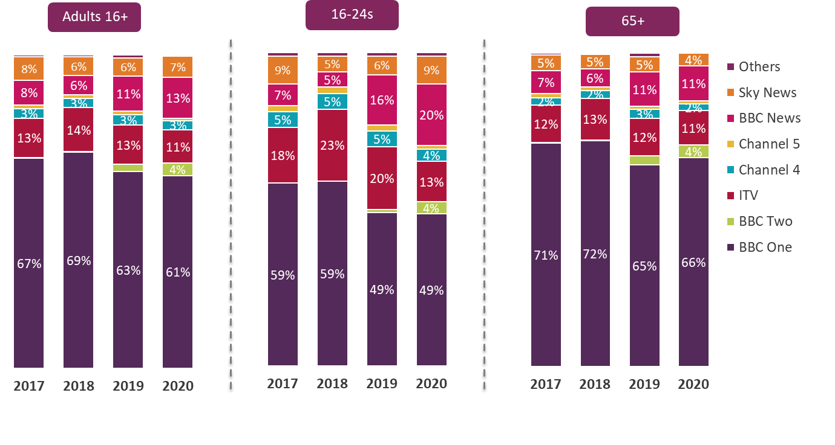
Proportion of national/international news viewing hours by channel group – 2017-2020
Industry data shows that in 2020, compared to 2019, BBC One and ITV formed a smaller proportion of news viewing hours, while BBC Two and the BBC News channel contributed to a greater proportion of news viewing hours
Figure 4.1
Source: BARB, Network. Network programming based on 4+ area filter. Genre = national/international news.
Channels include their HD and +1 variants. Others = all other channels that showed national/international news that are not any of the listed channels above.
Please note there was a change in the genre coding in 2020 and 2019 data was also amended. Data from 2019 onwards may not be directly comparable to previous years and may differ from the 2019 data published last year.

Slide 28
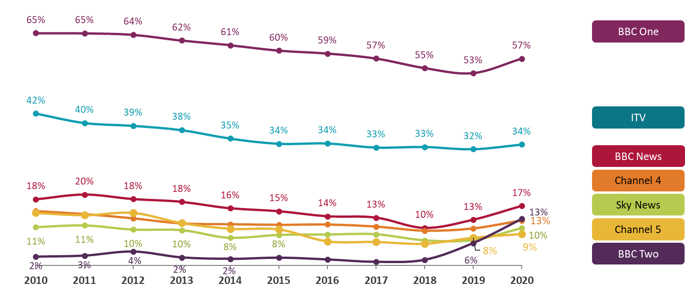
Average weekly reach of national/international news by channel - 2010 to 2020
All adults 16+
On average, 57% of adults in the UK watched news on BBC One each week in 2020, the highest reach of all channels.
Figure 4.2
Source: BARB, Network. Network programming based on 4+ area filter. Genre = national/international news.
Channels include their HD and +1 variants. Reach criteria = 3 consecutive minutes. Full weeks used for the correct calculation of weekly averages.
Please note there was a change in the genre coding in 2020 and 2019 data was also amended. Data from 2019 onwards may not be directly comparable to previous years and may differ from the 2019 data published last year.

Slide 29
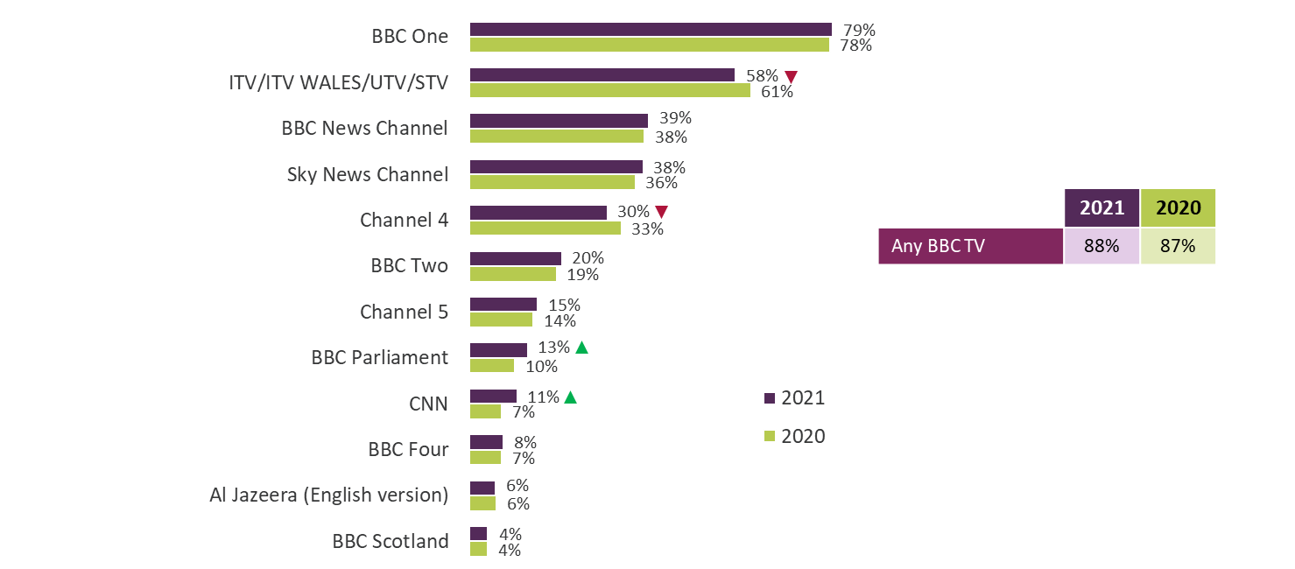
TV channels used for news nowadays
All using TV for news
Among the adults that use TV for news, BBC One remains the most-used channel, followed by ITV. Usage of ITV and Channel 4 has declined since 2020, whilst BBC Parliament and CNN have both increased
Figure 4.3
Source: Ofcom News Consumption Survey 2021 - ONLINE sample only Green/red triangles indicate statistically significant differences between 2021 and 2020
Question: D2a. Thinking specifically about television, which of the following do you use for news nowadays? Base: All using TV for news – 2021=2561, 2020=1949
Only sources with an incidence of >3% in 2021 are shown
2020 and 2021 ONLINE SAMPLE ONLY

Slide 30
TV channels used for news nowadays 2021 - by demographic group
All using TV for news
Males, those aged 65+ and minority ethnic groups are more likely than females, 16-24s and white adults to use most TV sources. The exception is ITV, where females and C2DEs are more likely to watch this channel for news
Figure 4.4
 | Total | Male | Female | 16-24 | 65+ | ABC1 | C2DE | Minority ethnic groups | White
BBC One | 79% | 79% | 78% | 72% | 87% | 81% | 76% | 74% | 79%
ITV/ITV WALES/UTV/STV | 58% | 53% | 62% | 52% | 62% | 53% | 65% | 51% | 58%
BBC News Channel | 39% | 44% | 34% | 32% | 47% | 42% | 35% | 46% | 38%
Sky News Channel | 38% | 44% | 32% | 35% | 35% | 39% | 35% | 48% | 37%
Channel 4 | 30% | 31% | 29% | 29% | 30% | 30% | 30% | 37% | 29%
BBC Two | 20% | 24% | 16% | 16% | 26% | 21% | 19% | 21% | 20%
Channel 5 | 15% | 15% | 14% | 11% | 18% | 13% | 18% | 19% | 14%
BBC Parliament | 13% | 16% | 9% | 11% | 15% | 14% | 12% | 12% | 13%
CNN | 11% | 14% | 7% | 8% | 8% | 11% | 9% | 22% | 9%
BBC Four | 8% | 9% | 6% | 10% | 7% | 8% | 7% | 15% | 7%
Al Jazeera (English version) | 6% | 7% | 4% | 4% | 7% | 6% | 5% | 12% | 5%
BBC Scotland | 4% | 5% | 4% | 3% | 3% | 4% | 5% | 3% | 4%
Source: Ofcom News Consumption Survey 2021 - ONLINE sample only
Question: D2a. Thinking specifically about television, which of the following do you use for news nowadays?
Base: All using TV for news 2021 - Total=2561, Male=1241, Female=1319, 16-24=398, 65+=579, ABC1=1466, C2DE=1082, Minority ethnic groups=354, White=2199
Green shading indicates significant differences between groups. Only sources with an incidence of >3% in 2021 are shown.

Slide 31
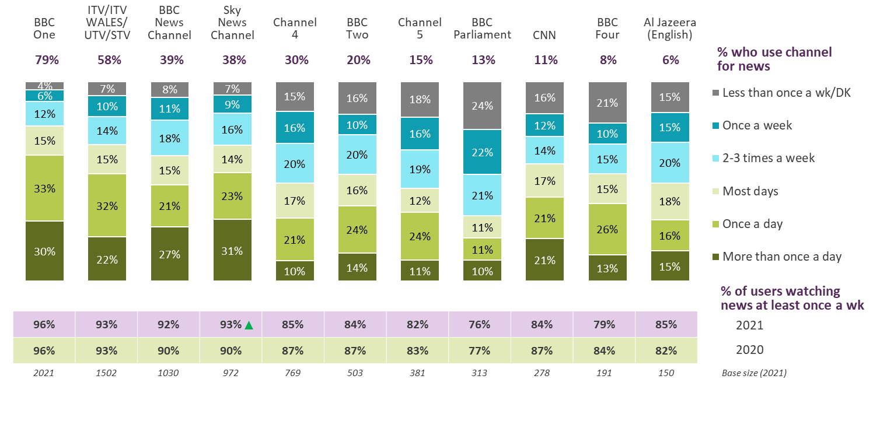
Frequency of consumption for main TV channels 2021
All using each source for news
BBC One is used most frequently for news. The percentage of Sky News users watching at least once a week has increased significantly over the past year from 90% to 93%
Figure 4.5
Source: Ofcom News Consumption Survey 2021 - ONLINE sample only Green/red triangles indicate statistically significant differences between 2021 and 2020
Question: D2b. And typically how often do you watch the news on...
Base: All who use each source for news 2021 (bases shown above, only sources used by 100+ respondents included)
2020 and 2021 ONLINE SAMPLE ONLY

Slide 32
News consumption via radio

Slide 33
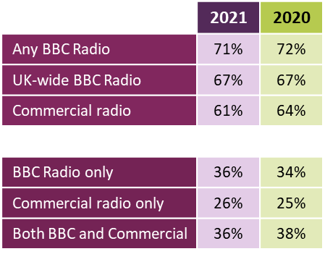
Radio stations used for news nowadays
All using radio for news
Among the adults that use radio for news, 7 in 10 claim to use a BBC station.
BBC Radio 2, 1 and 4 continue to be most used for news.
Figure 5.1
Source: Ofcom News Consumption Survey 2021 - ONLINE sample only Green/red triangles indicate statistically significant differences between 2021 and 2020
Question: D6a. Thinking specifically about radio stations, which of the following do you use for news nowadays?
Base: All using radio for news – 2021=1576, 2020=1331. Only sources with an incidence of >5% in 2021 are shown
Note: Radio stations include short news bulletins at the start of each hour which aren't able to be measured
through the industry metric, RAJAR. Our survey helps us understand the role radio plays in news consumption.
2020 and 2021 ONLINE SAMPLE ONLY

Slide 34
Radio stations used for news nowadays 2021 - by demographic group
All using radio for news
16-24s are more likely than those aged 65+ to use Radio 1, Capital, Heart and Kiss, those aged 65+ are more likely to use BBC Radio 4, 2, 5 Live and BBC local radio. ABC1s are more likely than C2DEs to listen to non-music radio stations, such as Radio 4, 5 Live, LBC and the BBC World Service
Figure 5.2
 | Total | Male | Female | 16-24 | 65+ | ABC1 | C2DE | Minority ethnic groups | White
BBC Radio 2 | 26% | 28% | 25% | 18% | 33% | 28% | 24% | 15% | 27%
BBC Radio 1 | 22% | 19% | 26% | 51% | 5% | 20% | 25% | 38% | 21%
BBC Radio 4 | 22% | 25% | 18% | 9% | 39% | 26% | 14% | 18% | 22%
Heart | 15% | 11% | 19% | 23% | 2% | 12% | 18% | 21% | 14%
BBC Radio 5 Live | 14% | 20% | 7% | 6% | 17% | 17% | 10% | 19% | 14%
Capital | 10% | 7% | 14% | 27% | 1% | 10% | 11% | 29% | 9%
Classic FM | 10% | 11% | 8% | 12% | 16% | 11% | 8% | 22% | 9%
Smooth Radio | 9% | 8% | 11% | 4% | 9% | 8% | 12% | 12% | 9%
LBC | 8% | 11% | 6% | 7% | 7% | 10% | 6% | 12% | 8%
BBC Radio Scotland/Wales/Ulster | 8% | 10% | 6% | 9% | 8% | 7% | 9% | 10% | 8%
talkSPORT/ talkSPORT2/ talkRADIO | 8% | 13% | 2% | 3% | 4% | 8% | 8% | 6% | 8%
BBC local radio in England | 7% | 8% | 6% | 2% | 12% | 6% | 9% | 2% | 8%
Absolute Radio | 7% | 7% | 7% | 4% | 2% | 6% | 10% | 3% | 8%
Magic | 6% | 4% | 9% | 5% | 3% | 5% | 8% | 4% | 7%
BBC World Service | 6% | 8% | 4% | 4% | 8% | 7% | 4% | 11% | 6%
Kiss | 6% | 5% | 7% | 17% | 1% | 5% | 9% | 14% | 5%
Other local commercial stations | 6% | 5% | 6% | 7% | 6% | 4% | 8% | 4% | 6%
Source: Ofcom News Consumption Survey 2021 - ONLINE sample only
Question: D6a. Thinking specifically about radio stations, which of the following do you use for news nowadays?
Base: All using radio for news 2021 - Total=1576, Male=813, Female=762, 16-24=194, 65+=351, ABC1=939, C2DE=630, Minority ethnic groups=163, White=1408
Green shading indicates significant differences between groups. Only sources with an incidence of >5% in 2021 are shown.

Slide 35
News consumption via newspapers

Slide 36

Daily newspapers used for news nowadays (print only)
All using printed newspapers for news
Among the adults who claim to consume news through print, the Daily Mail remains the most-used daily title followed by The Sun and The Metro, which has seen a significant decline since 2020
Figure 6.1
In total, 21% (33% in 2020) of print newspaper readers used daily ‘free-sheets’
Source: Ofcom News Consumption Survey 2021 - ONLINE sample only Green/red triangles indicate statistically significant differences between 2021 and 2020
Question: D3a. Thinking specifically about daily newspapers, which of the following do you use for news nowadays?
Base: All using print newspapers for news – 2021=1104, 2020=1003
Only sources with an incidence of >5% in 2021 are shown
Note: Daily free-sheets are the Metro and the Evening Standard
2020 and 2021 ONLINE SAMPLE ONLY

Slide 37
Sunday newspapers used for news nowadays (print only)
All using printed newspapers for news
The Mail on Sunday remains the most read Sunday title, followed by The Sunday Times, which has increased significantly, and The Sun on Sunday
Figure 6.2
In total, 2% (3% in 2020) of print newspaper readers used free local weekly newspapers
Source: Ofcom News Consumption Survey 2021 - ONLINE sample only Green/red triangles indicate statistically significant differences between 2021 and 2020
Question: D4a. Thinking specifically about weekly newspapers, which of the following do you use for news nowadays?
Base: All using print newspapers for news – 2021=1104, 2020=1003
Only sources with an incidence of >5% in 2021 are shown
2020 and 2021 ONLINE SAMPLE ONLY

Slide 38
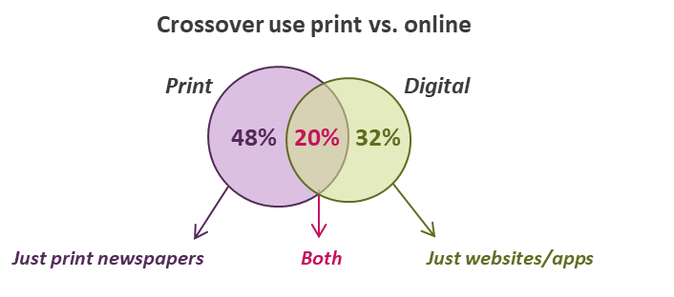
Print vs. digital newspaper readership 2021
All using newspapers (print + website/app) for news
The Daily Mail/Mail on Sunday remains the most widely-read news title overall. The Guardian/Observer and Daily Mail/Mail on Sunday are the most widely-read digital titles
Figure 6.3
Source: Ofcom News Consumption Survey 2021 - ONLINE sample only
Question: D3a/D4a. Thinking specifically about daily/weekly newspapers, which of the following do you use for news nowadays?
D8a. Thinking specifically about the internet, which of the following do you use for news nowadays?
Base: All using newspapers (print + website/app) for news – 2021=1691
2020 and 2021 ONLINE SAMPLE ONLY

Slide 39

Newspapers (print + website/app) used for news nowadays
All using newspapers (print + website/app) for news
Among the adults who claim to consume news through print or online newspapers, Daily Mail/Mail on Sunday remains the most-used title/site/app.
Figure 6.4
Source: Ofcom News Consumption Survey 2021 - ONLINE sample only Green/red triangles indicate statistically significant differences between 2021 and 2020
Question: D3a/D4a. Thinking specifically about daily/weekly newspapers, which of the following do you use for news nowadays? D8a. Thinking specifically about the internet, which of the following do you use for news nowadays?
Base: All using newspapers (print + website/app) for news – 2021=1691, 2020=1431
2020 and 2021 ONLINE SAMPLE ONLY

Slide 40
Newspapers (print + website/app) used for news nowadays 2021
- by demographic group
All using newspapers (print + website/app) for news
Among those using newspapers for news - 16-24s, ABC1s and people from minority ethnic groups are generally more likely to read more of the titles than 65+, C2DEs and white adults
Figure 6.5
 | Total | Male | Female | 16-24 | 65+ | ABC1 | C2DE | Minority ethnic groups | White
Daily Mail/Mail on Sunday | 42% | 41% | 43% | 40% | 48% | 41% | 43% | 43% | 42%
The Guardian/Observer | 29% | 29% | 30% | 53% | 16% | 33% | 22% | 44% | 27%
The Sun / Sun on Sunday | 23% | 23% | 23% | 27% | 15% | 17% | 34% | 29% | 22%
The Times/Sunday Times | 20% | 22% | 18% | 26% | 17% | 25% | 13% | 27% | 20%
Daily/Sunday Telegraph | 19% | 21% | 17% | 26% | 19% | 23% | 13% | 26% | 18%
The Metro | 18% | 20% | 16% | 17% | 13% | 17% | 21% | 31% | 17%
Local newspapers | 16% | 14% | 19% | 7% | 26% | 15% | 18% | 4% | 18%
Daily/Sunday Mirror | 15% | 16% | 13% | 21% | 12% | 12% | 20% | 28% | 13%
Daily/Sunday Express | 12% | 14% | 9% | 12% | 13% | 12% | 13% | 18% | 11%
Evening Standard | 9% | 11% | 7% | 8% | 7% | 11% | 6% | 14% | 9%
The Independent | 9% | 8% | 10% | 14% | 5% | 9% | 9% | 15% | 8%
The ‘i’ | 9% | 9% | 8% | 7% | 7% | 9% | 8% | 10% | 8%
Financial Times | 7% | 10% | 4% | 16% | 3% | 9% | 5% | 20% | 6%
Daily Star/Sunday Star | 7% | 8% | 6% | 13% | 2% | 5% | 11% | 13% | 7%
Source: Ofcom News Consumption Survey 2021 - ONLINE sample only
Question: D3a/4a. Thinking specifically about daily/weekly newspapers, which of the following do you use for news nowadays? D8a. Thinking specifically about the internet, which of the following do you use for news nowadays?
Base: All using newspapers (print + website/app) for news - Total=1691, Male=901, Female=790, 16-24=249, 65+=417, ABC1=1021, C2DE=661, Minority ethnic groups=240, White=1445. Green shading indicates significant differences between groups.

Slide 41
News consumption via social media

Slide 42
Social media used for news nowadays
All using social media for news
Among the adults who consume news via social media, while still most popular, fewer adults claim to use Facebook for news in 2021, with greater proportions using TikTok and Reddit
Figure 7.1
Source: Ofcom News Consumption Survey 2021 - ONLINE sample only
Question: D7a. Thinking specifically about social media (on any device), which of the following do you use for news nowadays?
Base: All using social media for news – 2021=1770 , 2020=1381 *Twitch added in 2021
Green/red triangles indicate statistically significant differences between 2021 and 2020
2020 and 2021 ONLINE SAMPLE ONLY

Slide 43
Social media used for news nowadays 2021 - by demographic group
All using social media for news
With the exception of Facebook, 16-24s and people from minority ethnic groups are more likely to use more of the social media apps/sites for news than those aged 65+ or white adults
Figure 7.2
 | Total | Male | Female | 16-24 | 65+ | ABC1 | C2DE | Minority ethnic groups | White
Facebook | 71% | 66% | 75% | 55% | 73% | 67% | 76% | 56% | 74%
Twitter | 46% | 52% | 41% | 55% | 26% | 51% | 40% | 50% | 45%
Instagram | 36% | 31% | 40% | 60% | 5% | 38% | 34% | 54% | 32%
WhatsApp | 31% | 32% | 30% | 31% | 18% | 31% | 31% | 49% | 27%
Snapchat | 16% | 14% | 17% | 42% | 0% | 16% | 16% | 29% | 13%
LinkedIn | 14% | 18% | 10% | 11% | 13% | 17% | 9% | 23% | 11%
TikTok | 12% | 10% | 14% | 27% | 1% | 13% | 11% | 20% | 10%
Reddit | 9% | 12% | 6% | 16% | 1% | 10% | 7% | 11% | 8%
Twitch | 4% | 6% | 3% | 7% | 0% | 4% | 4% | 3% | 4%
Tumblr | 3% | 3% | 3% | 5% | 0% | 3% | 2% | 3% | 3%
Viber | 3% | 3% | 2% | 2% | 0% | 3% | 2% | 6% | 2%
Other social media platform | 2% | 2% | 2% | 2% | 6% | 2% | 2% | 3% | 2%
Source: Ofcom News Consumption Survey 2021 - ONLINE sample only
Question: D7a. Thinking specifically about social media (on any device), which of the following do you use for news nowadays?
Base: All using social media for news – Total=1770, Male=755, Female=1013, 16-24=532, 65+=130, ABC1=1003, C2DE=758, Minority ethnic groups=420, White=1343
Green shading indicates significant differences between groups

Slide 44
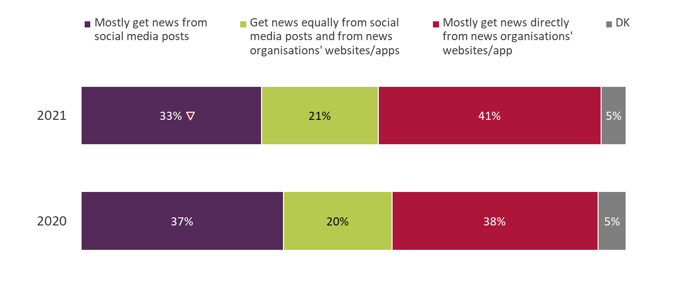
Use of social media versus news organisations’ websites/apps
All using social media for news
Those consuming news via social media remain more likely to do so ‘directly from news organisations’ websites or apps’. Significantly fewer adults now claim to mostly get their news from social media posts compared to 2020
Figure 7.3
Source: Ofcom News Consumption Survey 2021 - ONLINE sample only
Question: D15. And if you had to choose, which one of the following would you say is closest to the way you find out about news
when you’re online?
Base: All using social media for news – 2021=1770 , 2020=1381
Green/red triangles indicate statistically significant differences between 2021 and 2020
2020 and 2021 ONLINE SAMPLE ONLY

Slide 45
Use of social media versus news organisations’ websites/apps 2021 - by demographic group
All using social media for news
16-24s, females and C2DEs are more likely than 65+, male and ABC1s to get their news from social media posts. In contrast, males, ABC1s and those aged 65+ are more likely to get news directly from news organisations sites/apps
Figure 7.4
 | Total | Male | Female | 16-24 | 65+ | ABC1 | C2DE | Minority ethnic groups | White
Mostly get news from social media posts | 33% | 30% | 36% | 51% | 19% | 30% | 37% | 36% | 33%
Get news equally from social media posts and from news organisations' websites/apps | 21% | 18% | 24% | 18% | 27% | 20% | 24% | 18% | 22%
Mostly get news directly from news organisations' websites/app | 41% | 46% | 37% | 30% | 43% | 47% | 33% | 43% | 41%
Don’t know | 5% | 5% | 4% | 2% | 12% | 4% | 6% | 3% | 5%
Source: Ofcom News Consumption Survey 2021 - ONLINE sample only
Question: D15. And if you had to choose, which ONE of the following would you say is closest to the way you find out about news when you’re online?
Base: All using social media for news – Total=1770, Male=755, Female=1013, 16-24=532, 65+=130, ABC1=1003, C2DE=758, Minority ethnic groups=420, White=1343
Green shading indicates significant differences between groups

Slide 46
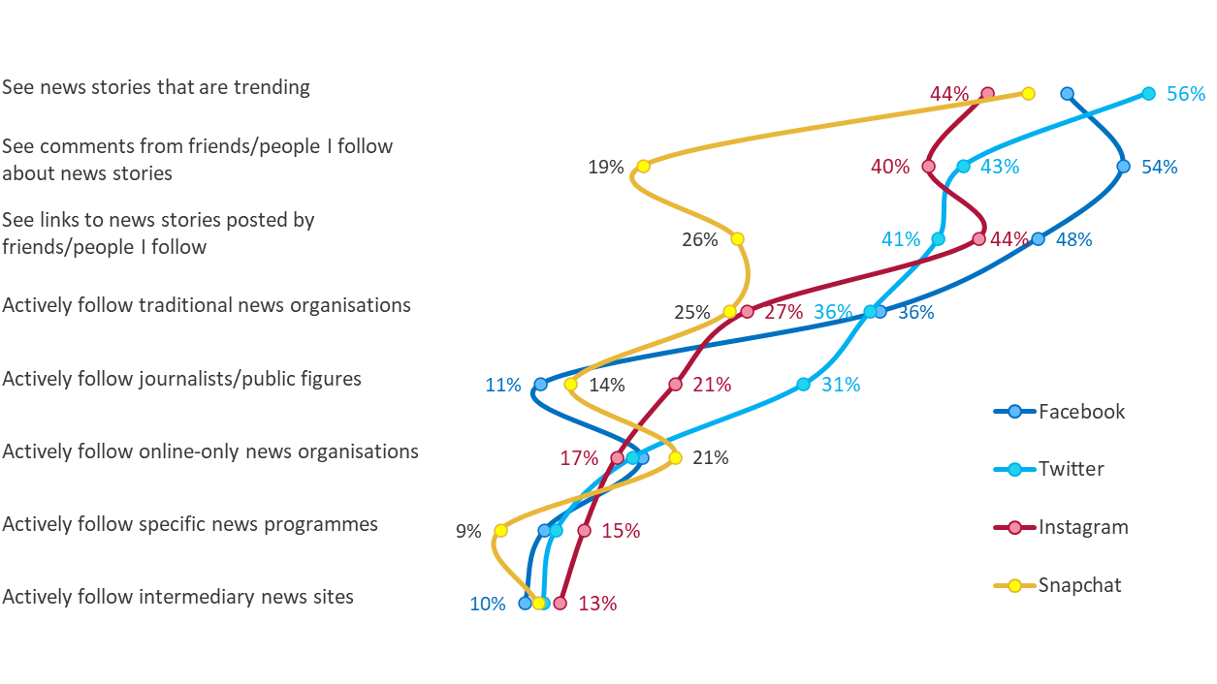
How news is accessed via social media 2021
All using each type of social media for news
As in 2020, news on social media sites is most likely to be accessed via ‘stories that are trending’, ‘seeing comments’ and ‘links to stories’
Figure 7.5
Source: Ofcom News Consumption Survey 2021 - ONLINE sample only
Question: D9. Earlier you mentioned that you get news from [social media site]. Which of the following do you do nowadays?
Base: All using each site for news 2021 – Facebook=1210, Twitter=812, Instagram=659, Snapchat=322

Slide 47
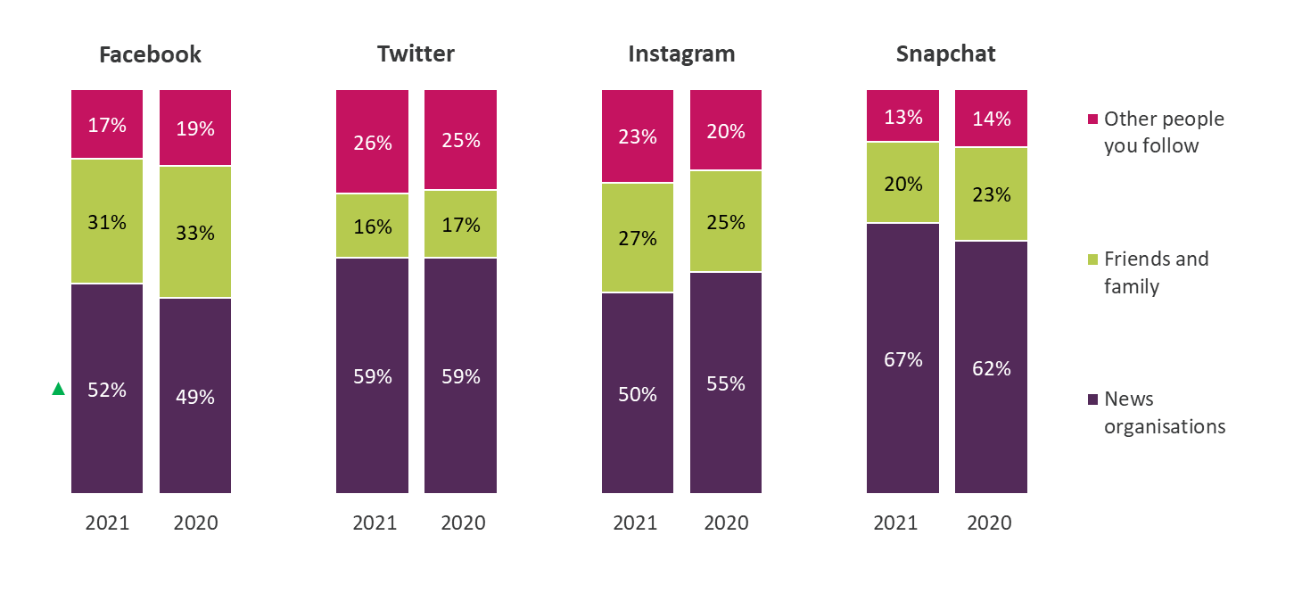
Proportion of news on social media accessed from each type of source
All using each type of social media for news
Those that consume news via social media are more likely to do so from news organisations than friends and family or other people they follow
Figure 7.6
Source: Ofcom News Consumption Survey 2021 - ONLINE sample only Green/red triangles indicate statistically significant differences between 2021 and 2020
Question: D10. Approximately what proportion of the news you get from [social media site] nowadays is from news organisations, friends and other people you follow?
Base: All using each site for news 2021/2020 – Facebook=1195/1030, Twitter=806/627, Instagram=651/485,
Snapchat=320/259
2020 and 2021 ONLINE SAMPLE ONLY

Slide 48
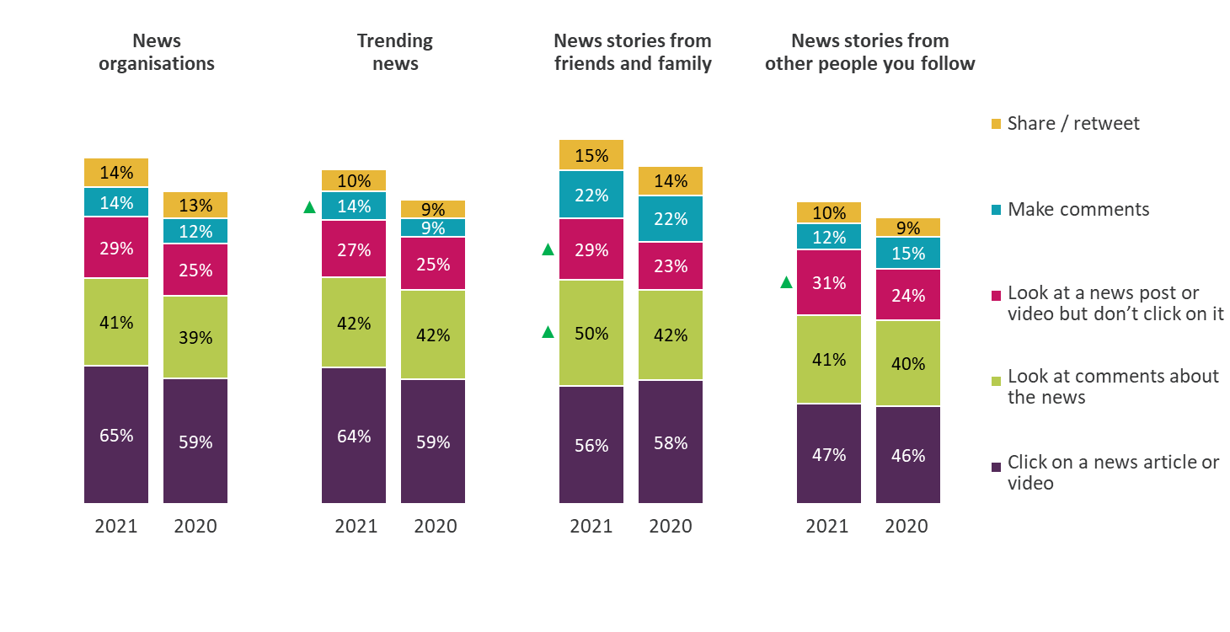
Actions normally taken when accessing news on Facebook
All accessing news from each source on Facebook
Facebook users are generally more likely than in 2020 to ‘make comments about the news’ and ‘look at news posts or videos without clicking on them’
Figure 7.7
Source: Ofcom News Consumption Survey 2021 - ONLINE sample only Green/red triangles indicate statistically significant differences between 2021 and 2020
Question: D11. Which, if any, of the following do you tend to do when you see posts from the following on Facebook?
Base: All accessing news from each source via Facebook 2021/2020 – News organisations=644/514, Trending
news=610/532, News stories from friends/family=833/751, News stories from other people you follow=874/788
Note: bars do not sum to 100% as respondents may carry out more than one action
2020 and 2021 ONLINE SAMPLE ONLY

Slide 49
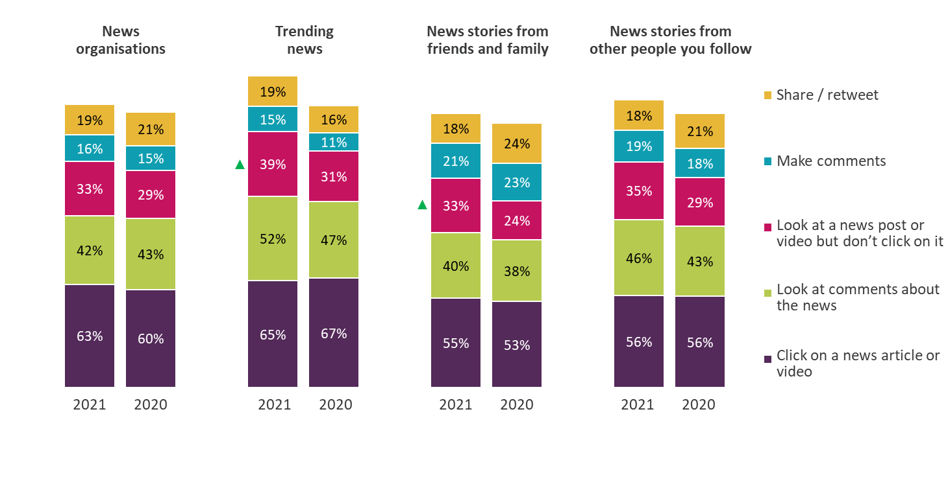
Actions normally taken when accessing news on Twitter
All accessing news from each source on Twitter
Twitter users are more likely to ‘look at news posts or videos without clicking on them’ compared to 2020
Figure 7.8
Source: Ofcom News Consumption Survey 2021 - ONLINE sample only Green/red triangles indicate statistically significant differences between 2021 and 2020
Question: D11. Which, if any, of the following do you tend to do when you see posts from the following on Twitter?
Base: All accessing news from each source via Twitter 2021/2020 – News organisations=477/364, Trending
news=472/361, News stories from friends/family=452/356, News stories from other people you follow=540/413
Note: bars do not sum to 100% as respondents may carry out more than one action
2020 and 2021 ONLINE SAMPLE ONLY

Slide 50
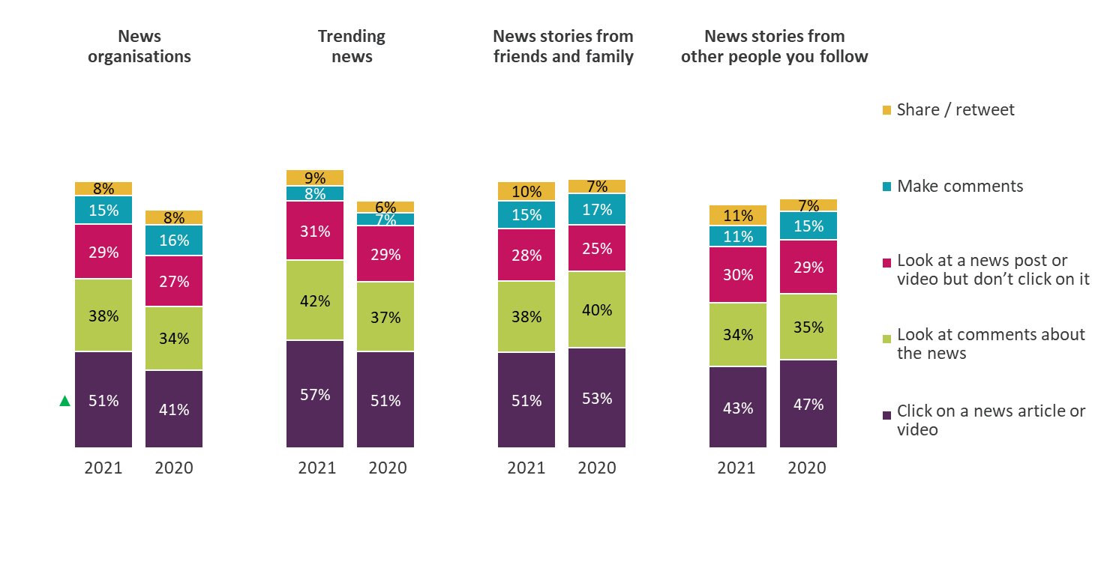
Actions normally taken when accessing news on Instagram
All accessing news from each source on Instagram
Instagram news users are more likely to click on news articles or videos, when accessing news via news organisations, compared to 2021
Figure 7.9
Source: Ofcom News Consumption Survey 2021 - ONLINE sample only Green/red triangles indicate statistically significant differences between 2021 and 2020
Question: D11. Which, if any, of the following do you tend to do when you see posts from the following on Instagram?
Base: All accessing news from each source via Instagram 2021/2020 – News organisations=354/269, Trending
news=300/221, News stories from friends/family=406/278, News stories from other people you follow=453/321
Note: bars do not sum to 100% as respondents may carry out more than one action
2020 and 2021 ONLINE SAMPLE ONLY

Slide 51
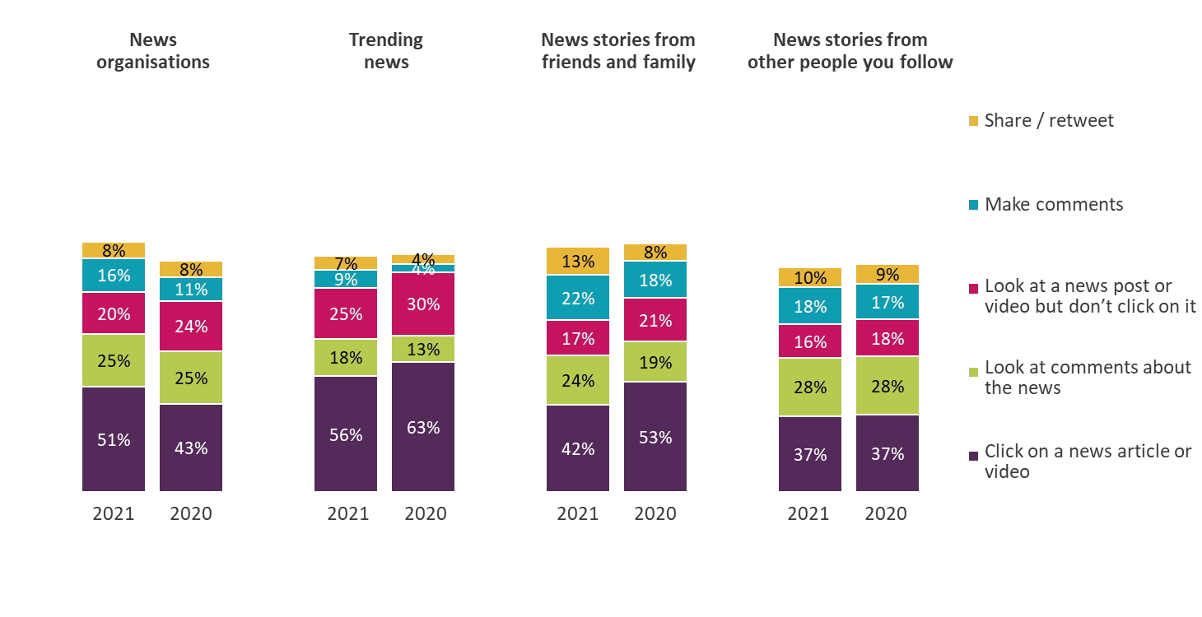
Actions normally taken when accessing news on Snapchat
All accessing news from each source on Snapchat
Users of Snapchat for news show similar levels of engagement in 2021 and 2020
Figure 7.10
Source: Ofcom News Consumption Survey 2021 - ONLINE sample only Green/red triangles indicate statistically significant differences between 2021 and 2020
Question: D11. Which, if any, of the following do you tend to do when you see posts from the following on Snapchat?
Base: All accessing news from each source via Snapchat 2021/2020 – News organisations=171/124, Trending
news=170/133, News stories from friends/family=119/105, News stories from other people you follow=142/122
Note: bars do not sum to 100% as respondents may carry out more than one action
2020 and 2021 ONLINE SAMPLE ONLY

Slide 52
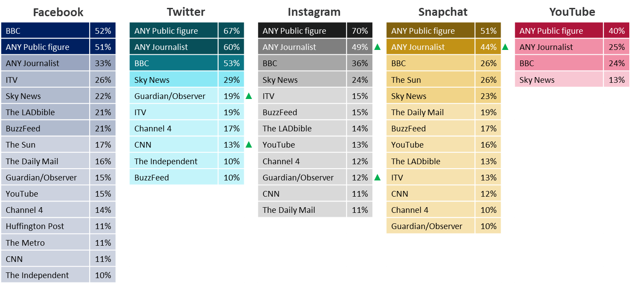
News organisations followed on social media - 2021
All accessing news organisations via each type of social media
Among those who follow news organisations on social media, BBC remains the most common source, followed by ITV on Facebook, Sky News on Twitter, Instagram and YouTube, and The Sun on Snapchat
Figure 7.11
Source: Ofcom News Consumption Survey 2021 - ONLINE sample only Green/red triangles indicate statistically significant differences between 2021 and 2020
Question: D12a/c. Which, if any, of the following news sources do you follow on [social media site]?
Base: All accessing news organisations via each type of social media - Facebook=644, Twitter=477,
Instagram=354, Snapchat=171, YouTube=373
Only sources with an incidence of 10%+ on each type of social media are shown
2020 and 2021 ONLINE SAMPLE ONLY

Slide 53
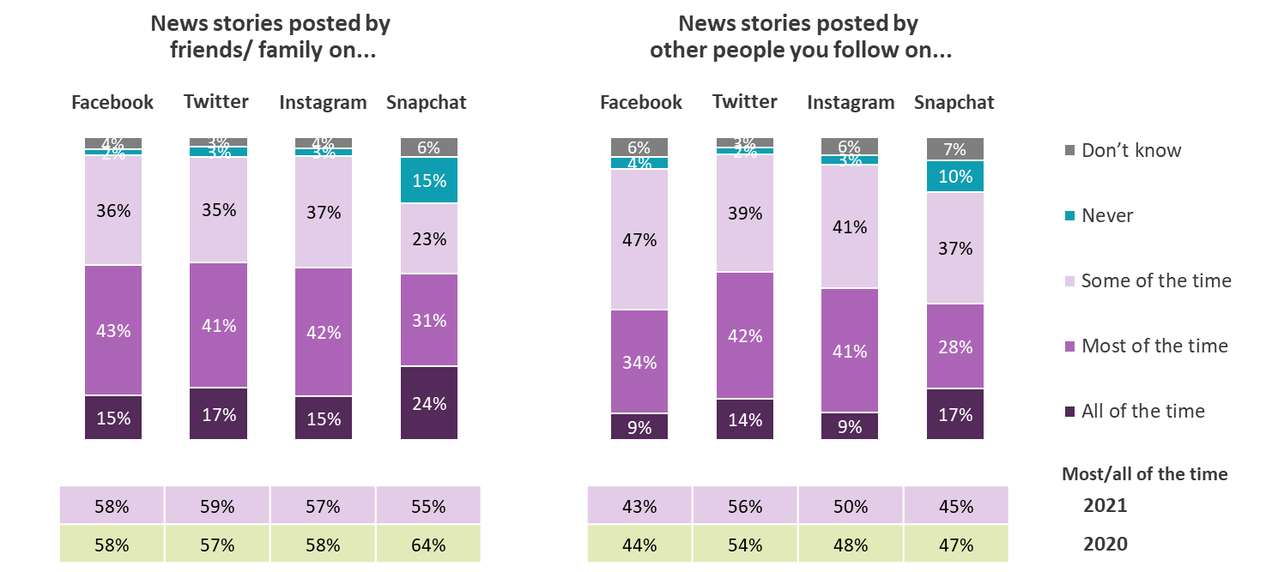
Awareness of the source of news stories posted on social media
All accessing news stories posted by friends/family or by other people via each type of social media
As in 2020, around half of social media news users say they know the source of their news stories ‘most’ or ‘all’ of the time
Figure 7.12
Source: Ofcom News Consumption Survey 2021 - ONLINE sample only Green/red triangles indicate statistically significant differences between 2021 and 2020
Question: D12b. Do you typically know the source of the news stories posted by your friends & family/by other people you follow?
Base: All accessing news stories posted by each source 2021/2020 –
Family/friends on Facebook=833/751, Twitter=452/356, Instagram=406/278, Snapchat=119/105 ;
Other people on Facebook=874/788, Twitter=540/413, Instagram=453/321, Snapchat=142/122
2020 and 2021 ONLINE SAMPLE ONLY

Slide 54
News consumption via websites or apps*
*Websites/apps includes any non-social media internet source

Slide 55
Ways to access news through the internet
All using other websites/apps for news*
Among adults who use online news other than social media, reading news stories online remains the most common way of accessing news
Figure 8.1
Source: Ofcom News Consumption Survey 2021 - ONLINE sample only Green/red triangles indicate statistically significant differences between 2021 and 2020
Question: D13. In which types of ways do you access and use news through internet sources nowadays?
Base: All using other websites/apps for news – 2021=1555, 2020=1252
*This question was not asked to those that said they used social media and no other types of websites/apps for news
2020 and 2021 ONLINE SAMPLE ONLY

Slide 56
Types of websites/apps used for news nowadays
All adults 16+
Websites/apps of TV and radio companies are used by a third of adults for news. Search engines are used less than in 2020
Figure 8.2
Source: Ofcom News Consumption Survey 2021 - ONLINE sample only Green/red triangles indicate statistically significant differences between 2021 and 2020
Question: C2. Which of the following do you use to get news?
Base: All adults 16+ – 2021=3327, 2020=2510
2020 and 2021 ONLINE SAMPLE ONLY

Slide 57
Types of websites/apps used for news nowadays 2021 - by demographic group
All adults 16+
ABC1s, males and people from minority ethnic groups tend to use a wider variety of online news sources nowadays compared to C2DEs, females and white people
Figure 8.3
 | Total | Male | Female | 16-24 | 65+ | ABC1 | C2DE | Minority ethnic groups | White
Websites/apps of TV and radio companies | 33% | 38% | 29% | 24% | 31% | 39% | 26% | 33% | 33%
Websites/apps of newspapers | 27% | 30% | 25% | 25% | 25% | 31% | 22% | 30% | 27%
Search engines | 25% | 26% | 23% | 24% | 21% | 26% | 23% | 32% | 24%
Websites/apps of news aggregation sites | 19% | 21% | 17% | 21% | 15% | 20% | 17% | 28% | 18%
Websites/apps of online news organisations | 17% | 18% | 15% | 19% | 12% | 19% | 13% | 23% | 16%
Websites/apps of news magazines | 10% | 12% | 9% | 12% | 3% | 12% | 8% | 18% | 9%
Blogs | 3% | 4% | 3% | 3% | 1% | 4% | 3% | 6% | 3%
Source: Ofcom News Consumption Survey 2021 - ONLINE sample only
Question: C2. Which of the following do you use to get news?
Base: All adults 16+ 2021 - Total=3327, Male=1602, Female=1723, 16-24=656, 65+=620, ABC1=1884, C2DE=1422, Minority ethnic groups=552, White=2762
Green shading indicates significant differences between groups

Slide 58
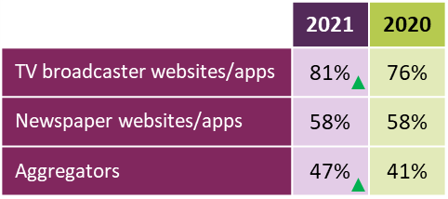
Websites/apps used for news nowadays
All using other websites/apps for news*
Among those using websites or apps for news, the BBC website/app remains the most used. Usage of the TV broadcaster and aggregator websites/apps have both increased since 2020.
Figure 8.4
Source: Ofcom News Consumption Survey 2021 - ONLINE sample only Green/red triangles indicate statistically significant differences between 2021 and 2020
Question: D8a. Thinking specifically about the internet, which of the following do you use for news nowadays?
Base: All using other websites/apps for news* - 2021=1555, 2020=1252
*This question was not asked to those that said they used social media and no other types of websites/apps site for news
Only sources with an incidence of 10%+ in 2021 are shown. **ITV/ITN – only includes mentions of ITV/ITN specifically, does not include mentions of STV or UTV.
2020 and 2021 ONLINE SAMPLE ONLY

Slide 59
Websites/apps used for news nowadays 2021 - by demographic group
All using other websites/apps for news*
Among those using websites/apps for news, females and people from minority ethnic groups generally claim to use a wider variety of website/apps for news than males and white people
Figure 8.5
 | Total | Male | Female | 16-24 | 65+ | ABC1 | C2DE | Minority ethnic groups | White
BBC website/app | 67% | 70% | 65% | 66% | 69% | 71% | 61% | 62% | 68%
Google (search engine) | 37% | 35% | 39% | 42% | 36% | 36% | 40% | 42% | 36%
Sky News website/app | 26% | 27% | 24% | 24% | 18% | 24% | 28% | 26% | 26%
Guardian/Observer website/app | 23% | 21% | 25% | 31% | 18% | 25% | 19% | 29% | 22%
The Daily Mail website/app | 22% | 19% | 25% | 18% | 27% | 22% | 23% | 22% | 22%
YouTube website/app | 18% | 19% | 16% | 32% | 9% | 16% | 20% | 38% | 14%
Google News | 17% | 18% | 16% | 13% | 14% | 17% | 19% | 25% | 16%
BuzzFeed website/app | 12% | 6% | 19% | 25% | 3% | 12% | 11% | 16% | 11%
ITV/ITN** website/app | 11% | 13% | 10% | 12% | 10% | 10% | 14% | 12% | 11%
Yahoo News website/app | 11% | 13% | 9% | 9% | 7% | 9% | 14% | 17% | 10%
MSN News website/app | 11% | 11% | 10% | 5% | 18% | 9% | 13% | 11% | 11%
Apple News app | 11% | 9% | 13% | 21% | 3% | 11% | 11% | 23% | 9%
The Telegraph website/app | 10% | 10% | 11% | 11% | 12% | 11% | 8% | 11% | 10%
Huffington Post website/app | 10% | 8% | 13% | 6% | 11% | 11% | 10% | 12% | 10%
The LADbible website/app | 10% | 8% | 12% | 19% | 1% | 9% | 11% | 12% | 9%
The Independent website/app | 10% | 9% | 10% | 12% | 8% | 9% | 11% | 13% | 9%
Source: Ofcom News Consumption Survey 2021 - ONLINE sample only
Question: D8a. Thinking specifically about the internet, which of the following do you use for news nowadays?
Base: All using other websites/apps for news 2021 - Total=1555, Male=806, Female=747, 16-24=303, 65+=254, ABC1=973, C2DE=574, Minority ethnic grps=299, White=1253 Green shading indicates significant differences between groups. Only sources with an incidence of 10%+ in 2021 are shown.
*This question was not asked to those that said they used social media and no other types of websites/apps site for news
**ITV/ITN – only includes mentions of ITV/ITN specifically, does not include mentions of STV or UTV

Slide 60
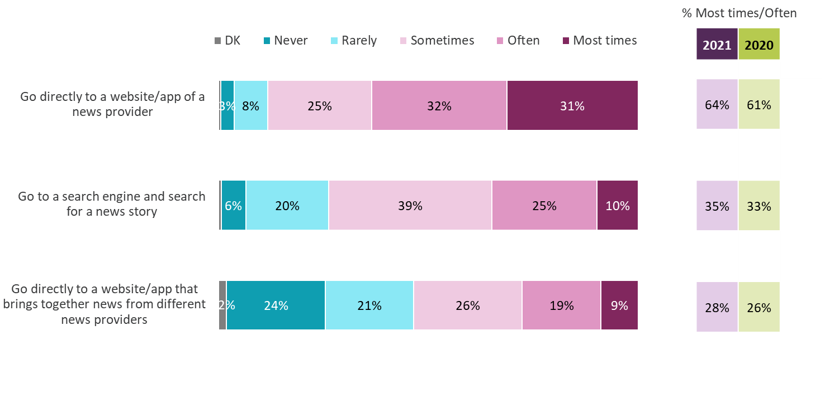
Gateways to online news, and frequency of use
All using other websites/apps for news*
Online news users remain more likely to go directly to the websites/apps of a news provider than via a search engine or a news aggregator
Figure 8.6
Source: Ofcom News Consumption Survey 2021 - ONLINE sample only Green/red triangles indicate statistically significant differences between 2021 and 2020
Question: D14. How often, if at all, you do each of the following when you want to get news?
Base: All using other websites/apps for news* - 2021=1555, 2020=1252
*This question was not asked to those that said they used social media and no other types of websites/apps for news
2020 and 2021 ONLINE SAMPLE ONLY

Slide 61
Gateways to online news, and frequency of use 2021 - by demographic group
All using other websites/apps for news*
People from minority ethnic groups and 16-24s are more likely to use a search engine or news aggregator compared to white people and those aged 65+
Figure 8.7
% Using most times/often | Total | Male | Female | 16-24 | 65+ | ABC1 | C2DE | Minority ethnic groups | White
Go directly to a website/app of a news provider | 64% | 66% | 61% | 58% | 58% | 66% | 60% | 62% | 64%
Go to a search engine and search for a news story | 35% | 34% | 36% | 43% | 20% | 33% | 39% | 48% | 33%
Go directly to a website/app that brings together news from different news providers | 28% | 31% | 24% | 31% | 17% | 27% | 29% | 41% | 26%
Source: Ofcom News Consumption Survey 2021 - ONLINE sample only
Question: D14. How often, if at all, you do each of the following when you want to get news?
Base: All using other websites/apps for news 2021 - Total=1555, Male=806, Female=747, 16-24=303, 65+=254, ABC1=973, C2DE=574, Minority ethnic grps=299, White=1253
This question was not asked to those that said they used social media and no other types of websites/apps site for news
Green shading indicates significant differences between groups

Slide 62
Podcast platforms used for news nowadays
All using podcasts for news
Among the adults who claim to consume news via podcasts nowadays, use of Spotify and GooglePlay for news has increased, whilst use of Apple podcasts has decreased since 2020
Figure 8.8
Source: Ofcom News Consumption Survey 2021 - ONLINE sample only Green/red triangles indicate statistically significant differences between 2021 and 2020
Question: D8ai. And, thinking specifically about podcasts you use for news nowadays on any device, how do you tend to access them? Which have you used in the
last month or so for news?
Base: All using podcasts for news – 2021=346, 2020=272
Only sources with an incidence of 5%+ in 2021 are shown
2020 and 2021 ONLINE SAMPLE ONLY

Slide 63
News consumption via magazines

Slide 64
Magazines used for news nowadays
All using magazines for news
Among adults who consume news via magazines, around one in five claim to read Private Eye, The Economist or Time
Figure 9.1
Source: Ofcom News Consumption Survey 2021 - ONLINE sample only Green/red triangles indicate statistically significant differences between 2021 and 2020
Question: D5a. Thinking specifically about magazines, which of the following do you use for news nowadays?
Base: All using magazines for news – 2021=316, 2020=332
2020 and 2021 ONLINE SAMPLE ONLY

Slide 65
Magazines used for news nowadays 2021 - by demographic group
All using magazines for news
Private Eye and The Economist are more likely to be read by males than females
Figure 9.2
 | Total | Male | Female | ABC1 | C2DE
Private Eye | 19% | 24% | 11% | 21% | 13%
The Economist | 18% | 23% | 11% | 19% | 15%
Time | 17% | 20% | 13% | 18% | 17%
The Week | 11% | 13% | 9% | 13% | 8%
Other magazines | 14% | 13% | 15% | 13% | 17%
Source: Ofcom News Consumption Survey 2021 - ONLINE sample only
Question: D5a. Thinking specifically about magazines, which of the following do you use for news nowadays?
Base: All using magazines for news 2021 - Total=316, Male=183, Female=133, ABC1=200, C2DE=116
Green shading indicates significant differences between groups

Slide 66
Multi-sourcing

Slide 67
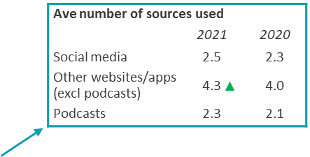
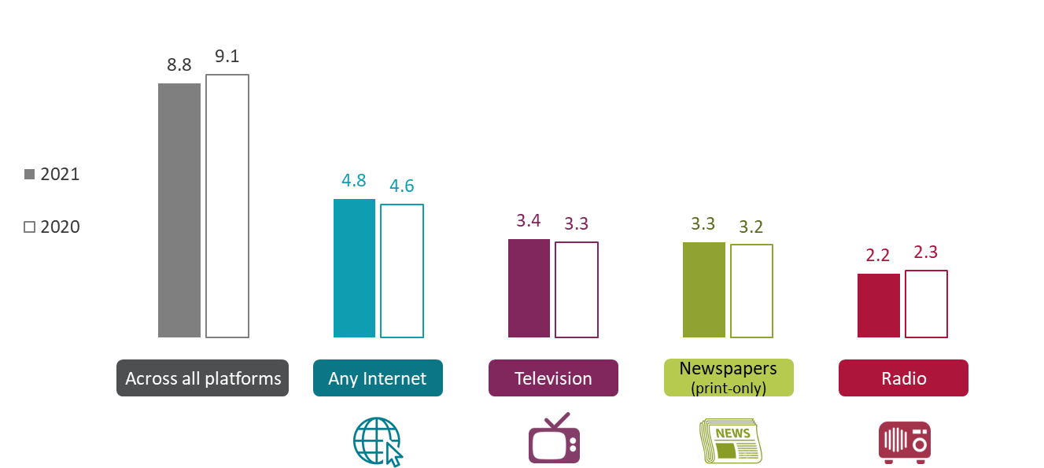
Average number of individual news sources used nowadays by platform
All using each platform for news
The average number of news sources remains flat overall, with 8.8 individual sources used on average across all platforms in 2021.
Figure 10.1
Source: Ofcom News Consumption Survey 2021 - ONLINE sample only Green/red triangles indicate statistically significant differences between 2021 and 2020
Question: D2a-D8a. Thinking specifically about <platform>, which of the following do you use for news nowadays?
Base: All using each platform for news 2021/2020 - All=3221/2441, Any internet=2461/1927, TV=2561/1949,
Newspapers=1104/1003, Radio=1576/1331
2020 and 2021 ONLINE SAMPLE ONLY

Slide 68
Average number of individual sources used across all platforms – by demographic group
All adults 16+ using TV/Newspapers/Radio/Internet/Magazines for news
People from minority ethnic groups, 16-34 age groups, males, those living in Northern Ireland and ABC1s tend to use a greater number of individual news sources
Figure 10.2
 | 2021 | 2020
Total | 8.8 | 9.1
Male | 9.5 | 9.9
Female | 8.1 | 8.3
16-34 | 9.8 | 9.8
35-54 | 8.6 | 8.9
55+ | 8.1 | 8.7
ABC1 | 9.2 | 9.6
C2DE | 8.3 | 8.4
Minority ethnic groups | 11.1 | 10.8
White | 8.5 | 8.9
England | 8.8 | 9.2
Scotland | 9.2 | 8.4
Wales | 7.4 | 8.5
Northern Ireland | 9.7 | 9.0
Source: Ofcom News Consumption Survey 2021 - ONLINE sample only
Question: D2a-D8a. Thinking specifically about <platform>, which of the following do you use for news nowadays?
Base: All adults 16+ using TV/Newspapers/Radio/Internet/Magazines for news – 2021=3221, 2020=2441
Darker purple shading indicates significant differences between groups in the 2021 data
2020 and 2021 ONLINE SAMPLE ONLY

Slide 69
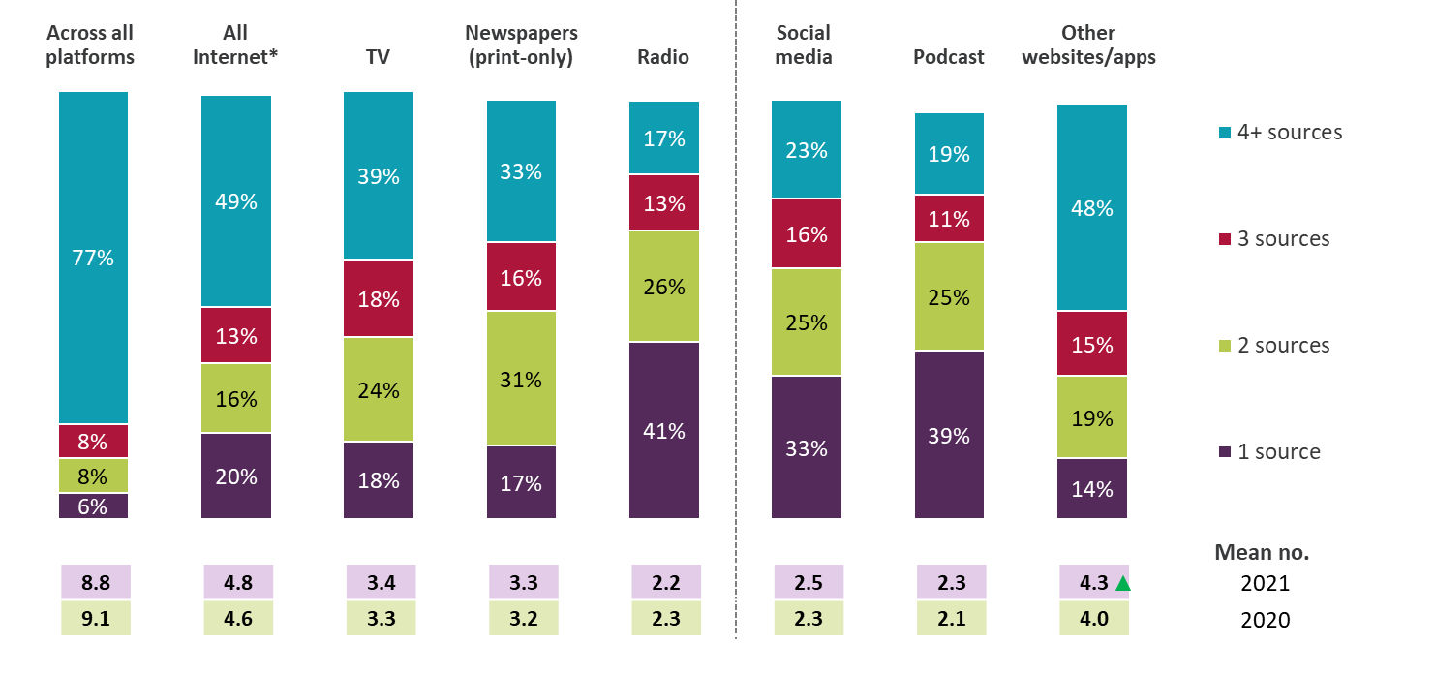
Number of individual sources used 2021 - by platform
All using each platform for news
As in previous years, other website/app news users use the highest number of individual news sources
Figure 10.3
Source: Ofcom News Consumption Survey 2021 - ONLINE sample only
Question: D2a-D8a. Thinking specifically about <platform>, which of the following do you use for news nowadays?
Base: All using each platform for news 2021 – All platforms=3221, All internet=2461, TV=2561, Newspapers=1104,
Radio=1576, Social media=1770, Podcasts=346, Other websites/apps=1555. *All internet is the sum of social media, podcasts and all other websites/apps
Note: Columns do not sum to 100% as some respondents did not name specific sources within a platform (zero sources)
2020 and 2021 ONLINE SAMPLE ONLY

Slide 70
Importance of sources and attitudes to news

Slide 71
Single most important news source
All adults 16+ using TV/Newspapers/Radio/Internet/Magazine for news
Compared to 2020, fewer adults nominate BBC One or ITV as their single most important source, while more nominate the BBC website/app
Figure 11.1
Source: Ofcom News Consumption Survey 2021 - ONLINE sample only Green/red triangles indicate statistically significant differences between 2021 and 2020
Question: E1a. Looking at all the sources of news you have just said that you use, which one is most important to you?
Base: All adults 16+ specifying at least one source for news – 2021=3183, 2020=2417
Only sources with an incidence of 2%+ in 2021 are shown.
2020 and 2021 ONLINE SAMPLE ONLY

Slide 72
Single most important news source 2021 - by demographic group
All adults 16+ using TV/Newspapers/Radio/Internet/Magazine for news
In general, those aged 65+, C2DE and white adults are more likely to say TV news sources are most important to them, while 16-24s and those from minority ethnic groups are more likely to nominate other websites/apps and social media
Figure 11.2
 | Total | Male | Female | 16-24 | 65+ | ABC1 | C2DE | Minority ethnic groups | White
BBC One | 19% | 19% | 20% | 14% | 31% | 19% | 19% | 12% | 20%
BBC website/app | 11% | 13% | 9% | 9% | 8% | 14% | 7% | 13% | 10%
ITV/ITV WALES/UTV/STV | 7% | 5% | 10% | 2% | 8% | 5% | 10% | 3% | 8%
Facebook | 6% | 4% | 8% | 8% | 1% | 3% | 9% | 7% | 6%
Sky News Channel | 6% | 6% | 5% | 4% | 7% | 5% | 6% | 4% | 6%
BBC News Channel | 4% | 5% | 4% | 3% | 5% | 4% | 5% | 4% | 4%
Twitter | 4% | 4% | 4% | 14% | 0% | 5% | 3% | 7% | 4%
Daily Mail/Mail on Sunday (print+website/app) | 4% | 4% | 4% | 2% | 7% | 4% | 3% | 1% | 4%
The Guardian/Observer (print+website/app) | 3% | 3% | 3% | 2% | 2% | 4% | 1% | 2% | 3%
BBC Radio 4 | 2% | 2% | 2% | 0% | 5% | 3% | 1% | 0% | 2%
ANY TV | 40% | 38% | 41% | 25% | 54% | 37% | 43% | 29% | 41%
ANY OTHER WEBSITES/APPS | 23% | 25% | 20% | 21% | 15% | 26% | 17% | 28% | 22%
ANY SOCIAL MEDIA | 14% | 12% | 17% | 36% | 1% | 13% | 17% | 26% | 13%
ANY RADIO | 8% | 9% | 7% | 5% | 8% | 9% | 8% | 4% | 9%
ANY NEWSPAPER | 8% | 9% | 6% | 5% | 16% | 9% | 6% | 6% | 8%
ANY MAGAZINE | 0% | 0% | 0% | 0% | 0% | 0% | 0% | 0% | 0%
Source: Ofcom News Consumption Survey 2021 - ONLINE sample only
Question: E1a. Looking at all the sources of news you have just said that you use, which one is most important to you?
Base: All adults 16+ specifying at least one source for news 2020 - Total=3183, Male=1540, Female=1641, 16-24=618, 65+=614, ABC1=1828, C2DE=1338, Minority ethnic groups=531, White=2641
Green shading indicates significant differences between groups. Only sources with an incidence of 2%+ in 2021 are shown.

Slide 73
Reasons for following news
All adults 16+
People follow the news to understand what is going on across the UK, their local area, region/nation and around the world
Figure 11.3
Source: Ofcom News Consumption Survey 2021 - ONLINE sample only Green/red triangles indicate statistically significant differences between 2021 and 2020
Question: G1. Thinking about some of the reasons people might have for following news, which of these reasons apply to you?
Base: All adults 16+ - 2021=3327, 2020=2510
2020 and 2021 ONLINE SAMPLE ONLY

Slide 74
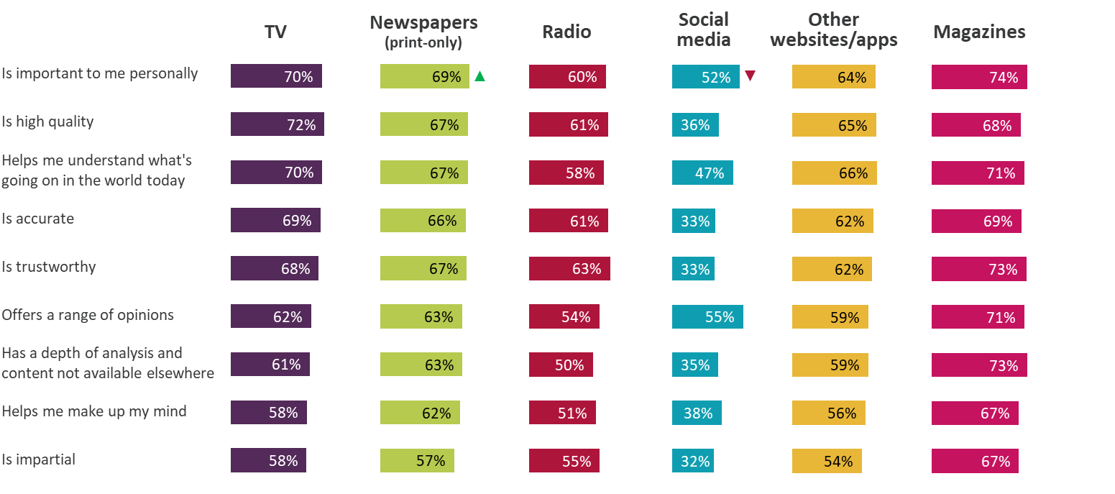
Attributes of news platforms - 2021
% of ratings from regular users who rated source highly (7-10)
When rated by their users on measures such as importance, trustworthiness and impartiality, the main news platforms’ ratings are largely in line with 2020, with social media receiving lower scores than other platforms
Figure 11.4
Source: Ofcom News Consumption Survey 2021 - ONLINE sample only Green/red triangles indicate statistically significant differences between 2021 and 2020
Question: E2. How important is <BRAND> as a source of news to you personally? E3. And to what extent do you think the following statements apply to <BRAND> as a news source? Answer using a scale of 1 to 10
Base: All ratings by those using each platform for news at least weekly (every 2-3 wks for weekly newspapers/mags)
2021 – TV=6017, Newspapers=2404, Radio=2227, Social media=2829, Other websites/apps=4185, Magazines=131
2020 and 2021 ONLINE SAMPLE ONLY

Slide 75
Attributes of TV sources (1) - 2021
% of regular users rating each source highly (7-10)
User attitudes towards TV sources are generally consistent with 2020.
Figure 11.5
 | BBC TV | ITV | Sky News | Channel 4 | Channel 5 | CNN | Al Jazeera
 | 2165 | 1381 | 895 | 641 | 305 | 234 | 136
Is important to me personally | 76% | 67% | 74% | 65% | 58% | 60% | 60%
Is high quality | 74% | 73% | 76% | 72% | 58% | 69% | 67%
Helps me understand what's going on in the world today | 73% | 69% | 75% | 70% | 56% | 70% | 69%
Is accurate | 71% | 70% | 72% | 70% | 57% | 68% | 59%
Is trustworthy | 68% | 70% | 70% | 71% | 60% | 63% | 60%
Offers a range of opinions | 58% | 64% | 68% | 67% | 51% | 64% | 57%
Has a depth of analysis and content not available elsewhere | 60% | 55% | 68% | 66% | 50% | 65% | 66%
Helps me make up my mind | 56% | 59% | 64% | 63% | 53% | 60% | 55%
Is impartial | 55% | 63% | 61% | 63% | 55% | 55% | 51%
Source: Ofcom News Consumption Survey 2021 - ONLINE sample only Green/red triangles indicate statistically significant differences between 2021 and 2020
Question: E2. How important is <BRAND> as a source of news to you personally? E3. And to what extent do you think the following statements apply to <BRAND> as a news source? Answer using a scale of 1 to 10
Base: All using each source for news at least weekly 2021 – bases shown above
2020 and 2021 ONLINE SAMPLE ONLY

Slide 76
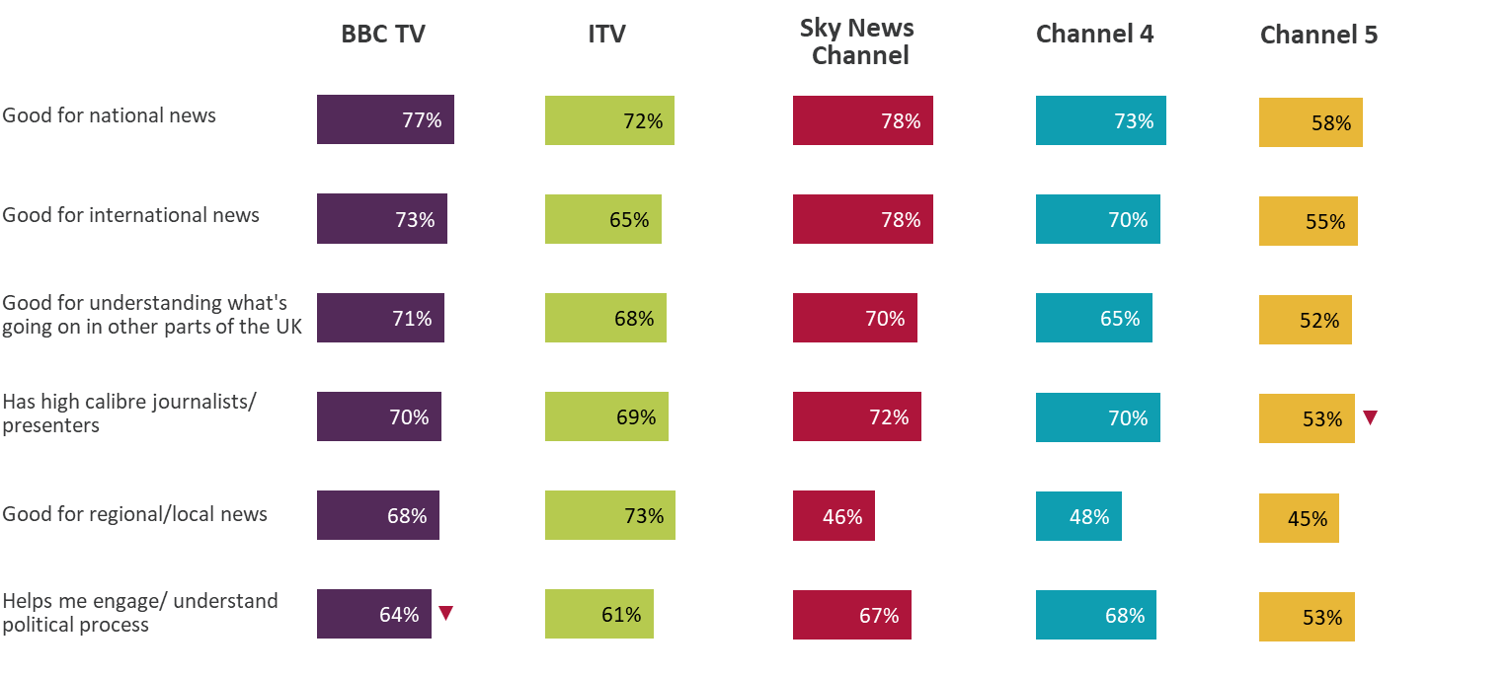
Attributes of TV sources (2) - 2021
% of regular users rating each source highly (7-10)
Users of Sky News give better ratings for ‘International news’, whereas users of ITV and BBC provide better scores for ‘Regional/Local’ news
Figure 11.6
Source: Ofcom News Consumption Survey 2021 - ONLINE sample only Green/red triangles indicate statistically significant differences between 2021 and 2020
Question: E2. How important is <BRAND> as a source of news to you personally? E3. And to what extent do you think the following statements apply to <BRAND> as a news source? Answer using a scale of 1 to 10
Base: All using each source for news at least weekly 2021 – BBC TV=2165, ITV=1381, Sky News Channel=895,
Channel 4=641, Channel 5=305
2020 and 2021 ONLINE SAMPLE ONLY

Slide 77
Attributes of Print Newspaper sources - 2021
% of regular users rating each source highly (7-10)
Readers of The Express and The Metro claim these titles are increasingly important to them. Readers of The Guardian, The Telegraph and The Times continue to rate these titles comparatively highly for ‘high quality’, ‘helps me understand what's going on’, ‘accurate’, ‘trustworthy’ and ‘depth of analysis’
Figure 11.7
 | Daily Mail/ Mail on Sunday | The Sun/ Sun on Sunday | The Times/ Sunday Times | The Guardian/ Observer | The Metro | Daily/Sunday Mirror | Daily/Sunday Telegraph | Daily/Sunday Express
 | 414 | 289 | 219 | 180 | 178 | 174 | 174 | 121
Is important to me personally | 70% | 61% | 70% | 76% | 60% | 68% | 74% | 77%
Is high quality | 68% | 56% | 79% | 86% | 53% | 63% | 80% | 67%
Helps me understand what's going on in the world today | 72% | 59% | 76% | 84% | 57% | 61% | 74% | 67%
Is accurate | 63% | 52% | 74% | 79% | 59% | 59% | 71% | 67%
Is trustworthy | 62% | 58% | 74% | 79% | 64% | 59% | 71% | 68%
Offers a range of opinions | 65% | 56% | 69% | 73% | 58% | 57% | 66% | 65%
Has a depth of analysis and content not available elsewhere | 64% | 56% | 73% | 79% | 47% | 59% | 74% | 69%
Helps me make up my mind | 60% | 55% | 67% | 75% | 52% | 58% | 65% | 67%
Is impartial | 51% | 48% | 61% | 66% | 56% | 49% | 59% | 57%
Source: Ofcom News Consumption Survey 2021 - ONLINE sample only Green/red triangles indicate statistically significant differences between 2021 and 2020
Question: E2. How important is <BRAND> as a source of news to you personally? E3. And to what extent do you think the following statements apply to <BRAND> as a news source? Answer using a scale of 1 to 10
Base: All using each source for news at least weekly (or every 2-3 weeks for weekly newspapers) 2021
– bases shown above
2020 and 2021 ONLINE SAMPLE ONLY

Slide 78
Attributes of Radio sources (1) - 2021
% of regular users rating each source highly (7-10)
BBC listeners are more likely to give high scores across the various attributes. Classic FM has declined on ‘helps me understand’, ‘helps me make up my mind’ and ‘impartial’ and Heart Radio has declined on ‘depth of analysis’
Figure 11.8
 | BBC Radio | Heart | Classic FM | Capital | Smooth Radio | LBC | talkSPORT/ talkSPORT2/ talkRADIO
 | 1082 | 196 | 147 | 142 | 124 | 122 | 102
Is important to me personally | 67% | 51% | 49% | 51% | 49% | 65% | 59%
Is high quality | 74% | 47% | 44% | 55% | 45% | 60% | 63%
Helps me understand what's going on in the world today | 70% | 45% | 39% | 50% | 42% | 66% | 51%
Is accurate | 71% | 52% | 47% | 55% | 45% | 53% | 63%
Is trustworthy | 72% | 55% | 52% | 55% | 47% | 58% | 69%
Offers a range of opinions | 63% | 45% | 33% | 47% | 38% | 67% | 64%
Has a depth of analysis and content not available elsewhere | 59% | 34% | 30% | 43% | 34% | 58% | 62%
Helps me make up my mind | 60% | 42% | 35% | 48% | 38% | 56% | 60%
Is impartial | 61% | 49% | 47% | 49% | 46% | 44% | 66%
Source: Ofcom News Consumption Survey 2021 - ONLINE sample only Green/red triangles indicate statistically significant differences between 2021 and 2020
Question: E2. How important is <BRAND> as a source of news to you personally? E3. And to what extent do you think the following statements apply to <BRAND> as a news source? Answer using a scale of 1 to 10
Base: All using each source for news at least weekly 2021 – bases shown above
2020 and 2021 ONLINE SAMPLE ONLY

Slide 79
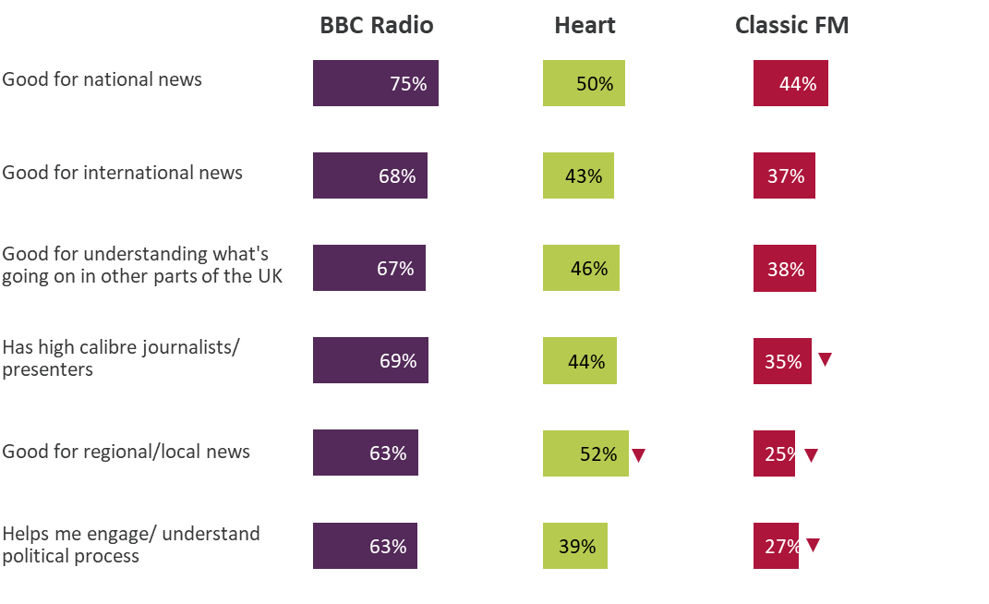
Attributes of Radio sources (2) - 2021
% of regular users rating each source highly (7-10)
Again, BBC listeners are more likely to give high scores across the various attributes. Classic FM listeners give lower ratings for ‘high calibre presenters’, ‘good for regional/local news’ and ‘helps me engage with the political process’ compared to 2020
Figure 11.9
Source: Ofcom News Consumption Survey 2021 - ONLINE sample only Green/red triangles indicate statistically significant differences between 2021 and 2020
Question: E2. How important is <BRAND> as a source of news to you personally? E3. And to what extent do you think the following statements apply to <BRAND> as a news source? Answer using a scale of 1 to 10
Base: All using each source for news at least weekly 2021 – BBC Radio=1082, Heart=135, Classic FM=116
2020 and 2021 ONLINE SAMPLE ONLY

Slide 80
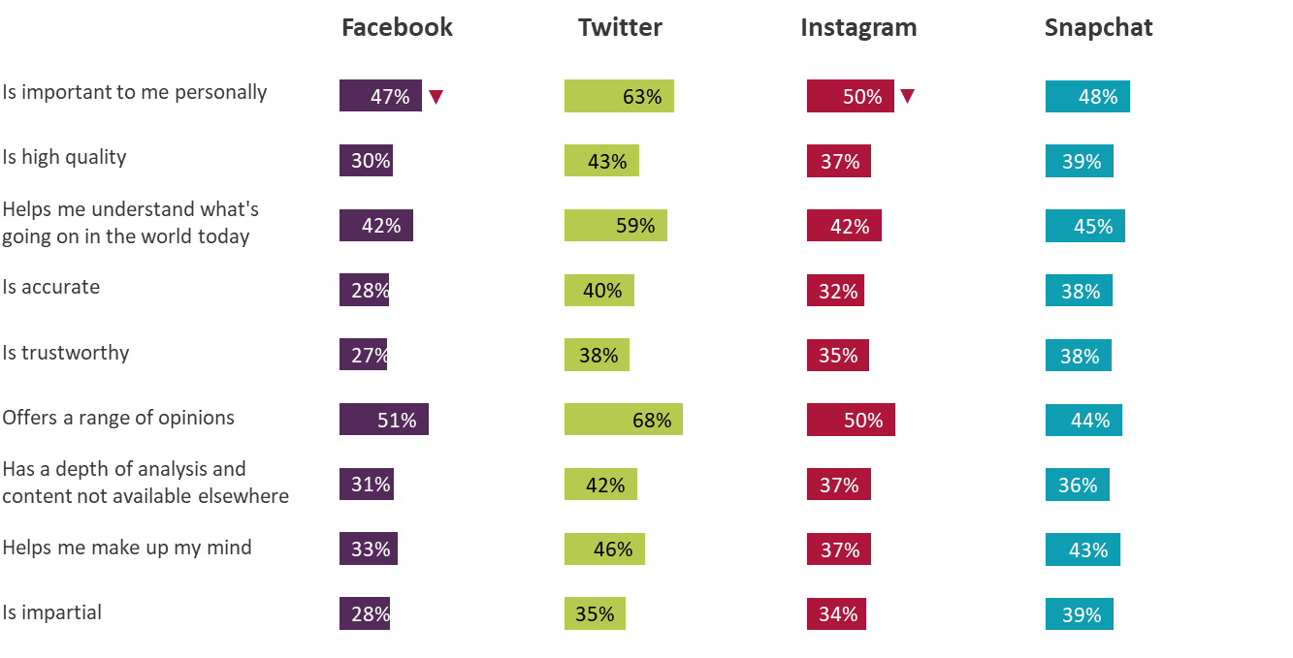
Attributes of Social Media - 2021
% of regular users rating each source highly (7-10)
Social media platforms continue to score relatively poorly, especially across ‘trustworthy’, ‘impartial’, ‘accurate’ and ‘high quality’. The importance of Facebook and Instagram have both declined since 2020
Figure 11.10
Source: Ofcom News Consumption Survey 2021 - ONLINE sample only Green/red triangles indicate statistically significant differences between 2021 and 2020
Question: E2. How important is <BRAND> as a source of news to you personally? E3. And to what extent do you think the following statements apply to <BRAND> as a news source? Answer using a scale of 1 to 10
Base: All using each source for news at least weekly 2021 – Facebook=1150, Twitter=771, Instagram=614,
Snapchat=294
2020 and 2021 ONLINE SAMPLE ONLY

Slide 81
Attributes of Other Websites/Apps - 2021
% of regular users rating each source highly (7-10)
As in previous years, BBC, The Guardian and Sky News users are more likely to rate these websites/apps relatively highly. Compared to 2020, Sky News receives higher rating for ‘trustworthy’, whilst BBC receives higher rating for ‘impartial’
Figure 11.11
 | BBC website/app | Sky News website/app | Guardian/ Observer | Daily Mail website/app | YouTube | Google News | MSN News | ITV/ITN* website/app | Yahoo News | Telegraph website/app | Independent website/app | Huffington Post | The Sun website/app
 | 1004 | 350 | 320 | 301 | 267 | 228 | 165 | 160 | 150 | 127 | 125 | 113 | 108
Is important to me personally | 78% | 72% | 67% | 60% | 56% | 72% | 56% | 67% | 60% | 59% | 56% | 43% | 49%
Is high quality | 79% | 72% | 79% | 50% | 48% | 61% | 52% | 70% | 56% | 72% | 68% | 48% | 43%
Helps me understand what's going on in the world today | 78% | 74% | 78% | 56% | 55% | 66% | 56% | 68% | 60% | 68% | 70% | 47% | 49%
Is accurate | 75% | 72% | 77% | 45% | 43% | 53% | 50% | 70% | 57% | 66% | 68% | 50% | 44%
Is trustworthy | 74% | 72% | 75% | 44% | 39% | 54% | 45% | 68% | 60% | 69% | 62% | 51% | 47%
Offers a range of opinions | 63% | 66% | 64% | 50% | 62% | 62% | 52% | 64% | 56% | 55% | 60% | 50% | 46%
Has a depth of analysis and content not available elsewhere | 67% | 66% | 76% | 50% | 50% | 53% | 38% | 60% | 46% | 68% | 62% | 47% | 43%
Helps me make up my mind | 63% | 62% | 68% | 48% | 49% | 57% | 45% | 59% | 53% | 60% | 54% | 44% | 37%
Is impartial | 65% | 63% | 54% | 35% | 45% | 55% | 43% | 62% | 53% | 51% | 48% | 41% | 34%
Source: Ofcom News Consumption Survey 2021 - ONLINE sample only Green/red triangles indicate statistically significant differences between 2021 and 2020
Question: E2. How important is <BRAND> as a source of news to you personally? E3. And to what extent do you think the following statements apply to <BRAND> as a news source? Answer using a scale of 1 to 10
Base: All using each source for news at least weekly 2021 – bases shown above
*ITV/ITN website/app – only includes ratings of ITV/ITN specifically, does not include ratings of STV website/app
2020 and 2021 ONLINE SAMPLE ONLY

Slide 82
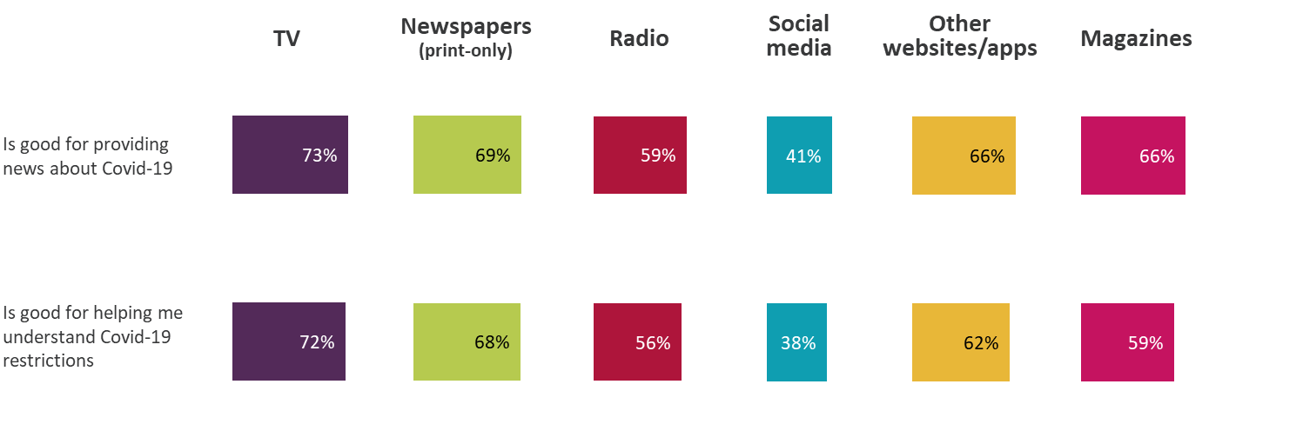
Attributes of news platforms on COVID-19 issues - 2021
% of ratings from regular users who rated source highly (7-10)
When rated by their users, TV receives the highest rating for ‘providing news about Covid-19’ and ‘helping people to understand the restrictions’. Social media scores poorly compared to all other platforms
Figure 11.12
Source: Ofcom News Consumption Survey 2021 - ONLINE sample only
Question: F10. Thinking now about Covid-19, to what extent do you think these statements apply to <BRAND> as a news source? Answer using a scale of 1 to 10
Base: All ratings by those using each platform for news at least weekly (every 2-3 wks for weekly newspapers/mags) 2021 – TV=6017, Newspapers=2404, Radio=2230, Social media=2829, Other websites/apps=4185, Magazines=131

Slide 83
Attributes of individual TV/Print Newspaper/Radio sources on COVID-19 issues - 2021
% of regular users rating each source highly (7-10)
BBC TV, Sky News and ITV are rated highly by their users for ‘providing news about Covid-19’ and ‘helping people to understand the restrictions’, as are The Guardian/Observer and The Times/Sunday Times.
Figure 11.13
 | BBC TV | ITV | Sky News | Channel 4 | Channel 5 | CNN | Al Jazeera
 | 2165 | 1381 | 895 | 641 | 305 | 234 | 136
Is good for providing news about Covid-19 | 78% | 74% | 76% | 72% | 61% | 59% | 52%
Is good for helping me understand Covid-19 restrictions | 76% | 74% | 76% | 71% | 61% | 54% | 43%
 | Daily Mail/ Mail on Sunday | The Sun/ Sun on Sunday | The Times/ Sunday Times | The Guardian/ Observer | The Metro | Daily/Sunday Mirror | Daily/Sunday Telegraph | Daily/Sunday Express |  | BBC Radio | Heart | Classic FM | Capital | Smooth Radio | LBC | talkSPORT/ talkSPORT2/ talkRADIO
 | 414 | 289 | 219 | 180 | 178 | 174 | 174 | 121 |  | 1085 | 196 | 147 | 142 | 124 | 122 | 102
Is good for providing news about Covid-19 | 73% | 65% | 75% | 79% | 60% | 65% | 72% | 71% |  | 71% | 48% | 39% | 55% | 40% | 68% | 44%
Is good for helping me understand Covid-19 restrictions | 68% | 62% | 76% | 82% | 60% | 62% | 72% | 71% |  | 67% | 45% | 41% | 55% | 41% | 65% | 42%
Source: Ofcom News Consumption Survey 2021 - ONLINE sample only
Question: F10. Thinking now about Covid-19, to what extent do you think these statements apply to <BRAND> as a news source? Answer using a scale of 1 to 10
Base: All using each source for news at least weekly (or every 2-3 weeks for weekly newspapers) 2021 – bases shown above

Slide 84
Attributes of Social Media and Other Websites/Apps on COVID-19 issues - 2021
% of regular users rating each source highly (7-10)
The BBC website is rated highly by its users for ‘providing news about Covid-19’ and ‘helping people to understand the restrictions’. The social media platforms score poorly compared to all other platforms
Figure 11.14
 | Facebook | Twitter | Instagram | Snapchat
 | 1150 | 771 | 614 | 294
Is good for providing news about Covid-19 | 36% | 54% | 37% | 37%
Is good for helping me understand Covid-19 restrictions | 36% | 45% | 36% | 35%
 | BBC website/app | Sky News website/app | Guardian/ Observer | Daily Mail website/app | YouTube | Google News | MSN News | ITV/ITN* website/app | Yahoo News | Telegraph website/app | Independent website/app | Huffington Post | The Sun website/app
 | 1004 | 350 | 320 | 301 | 267 | 228 | 165 | 160 | 150 | 127 | 125 | 113 | 108
Is good for providing news about Covid-19 | 82% | 72% | 74% | 59% | 49% | 68% | 51% | 70% | 60% | 65% | 64% | 40% | 60%
Is good for helping me understand Covid-19 restrictions | 79% | 72% | 67% | 56% | 43% | 63% | 46% | 69% | 55% | 60% | 60% | 32% | 54%
Source: Ofcom News Consumption Survey 2021 - ONLINE sample only
Question: F10. Thinking now about Covid-19, to what extent do you think these statements apply to <BRAND> as a news source? Answer using a scale of 1 to 10
Base: All using each source for news at least weekly 2021 – bases shown above
*ITV/ITN website/app – only includes ratings of ITV/ITN specifically, does not include ratings of STV website/app

Slide 85
Local news

Slide 86
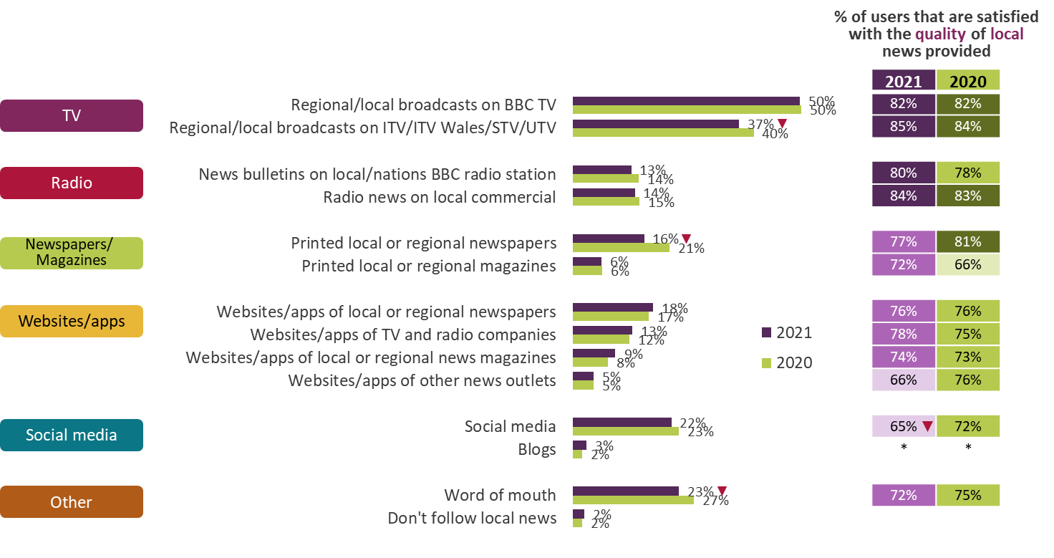
Platforms used to access local news
All adults 16+ who follow news
TV remains the most used platform for accessing local news. Compared to 2020, adults are less satisfied with the local news provided via social media
Figure 12.1
Source: Ofcom News Consumption Survey 2021 - ONLINE sample only Green/red triangles indicate statistically significant differences between 2021 and 2020
Question: F8: Thinking particularly about local news, which of the following do you use? Base: All adults 16+ who follow news – 2021=3234, 2020=2446
F9. How satisfied are you with the quality of the local news available from [source]?
Base: All using each source – 2021=144-1599, 2020=110-1188 *sample size <100
2020 and 2021 ONLINE SAMPLE ONLY

Slide 87
News consumption in the nations

Slide 88
Platforms used for news in general nowadays – by Nation
All adults 16+ in each Nation
TV remains the most used platform for accessing news within each nation
Figure 13.1
Source: Ofcom News Consumption Survey 2021 – COMBINED CATI & ONLINE sample
Question: C1. Which of the following platforms do you use for news nowadays?
Base: All adults 16+ 2021/2020 – Eng=3123, Scot=529, Wales=478, NI=475
*Internet includes use of social media, podcasts and all other websites/apps accessed via any device
**Other websites/apps includes any non-social media internet source (excluding podcasts)
Data not comparable to previous surveys, due to Covid-19 enforced methodological changes

Slide 89
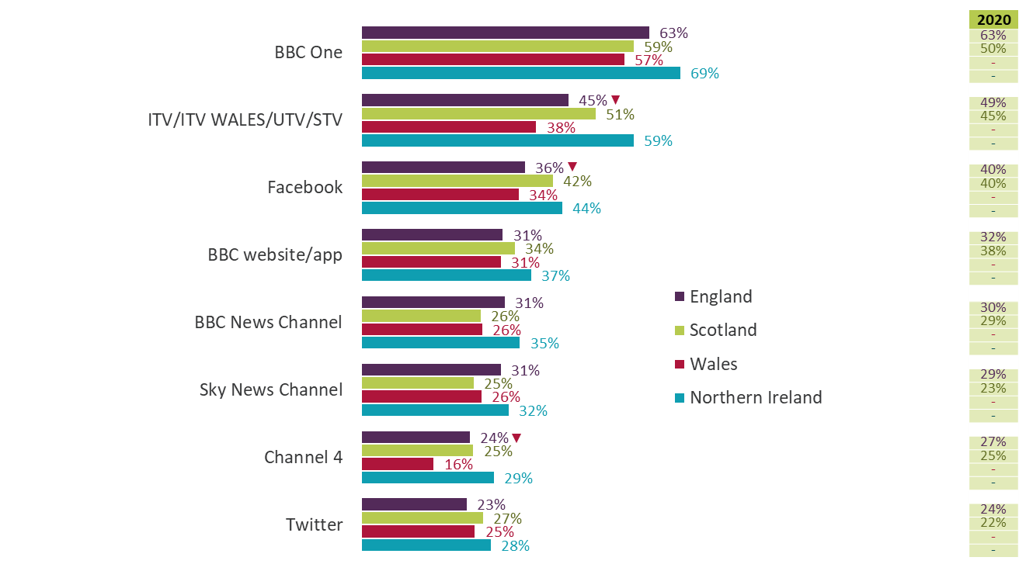
Top sources for news in general nowadays – by Nation
All adults 16+ in each Nation
BBC One is the most used news source across all four nations for general news nowadays
Figure 13.2
Source: Ofcom News Consumption Survey 2021 - ONLINE sample only Green/red triangles indicate statistically significant differences between 2021 and 2020
Question: D2a-D8a. Thinking specifically about <platform>, which of the following do you use for news nowadays?
Base: All adults 16+ 2021/2020 – England=2522/2149, Scotland=303/182, Wales=252/103 ⁻, Northern Ireland=250/76 ⁻
⁻ 2020 data not shown here as sample size =103/76
Only sources with an incidence of 20%+ in 2021 for the Total sample are shown
2020 and 2021 ONLINE SAMPLE ONLY

Slide 90
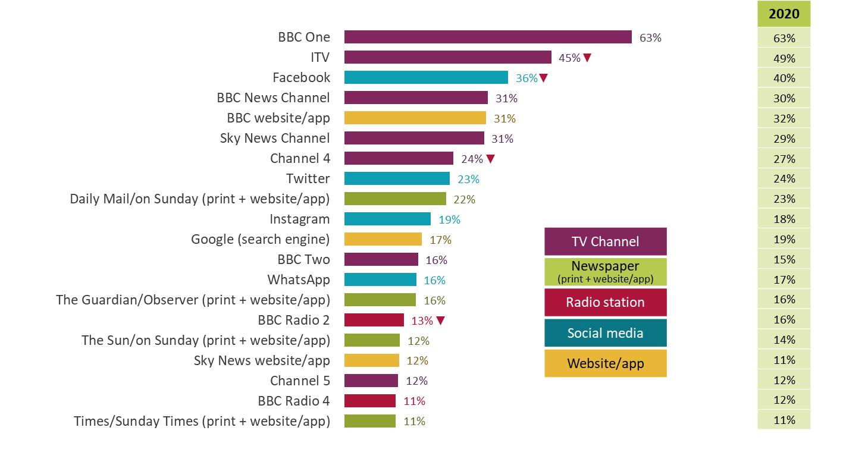
Top 20 sources for news in general - England
% of adults 16+ in England using each source for news nowadays
Almost two thirds of adults in England claim to use BBC One for news. Fewer people use ITV, Facebook, Channel 4 and BBC Radio 2 compared to last year
Figure 13.3
Source: Ofcom News Consumption Survey 2021 - ONLINE sample only Green/red triangles indicate statistically significant differences between 2021 and 2020
Question: D2a-D8a. Thinking specifically about <platform>, which of the following do you use for news nowadays?
Base: All adults 16+ in England – 2021=2522, 2020=2149
2020 and 2021 ONLINE SAMPLE ONLY

Slide 91
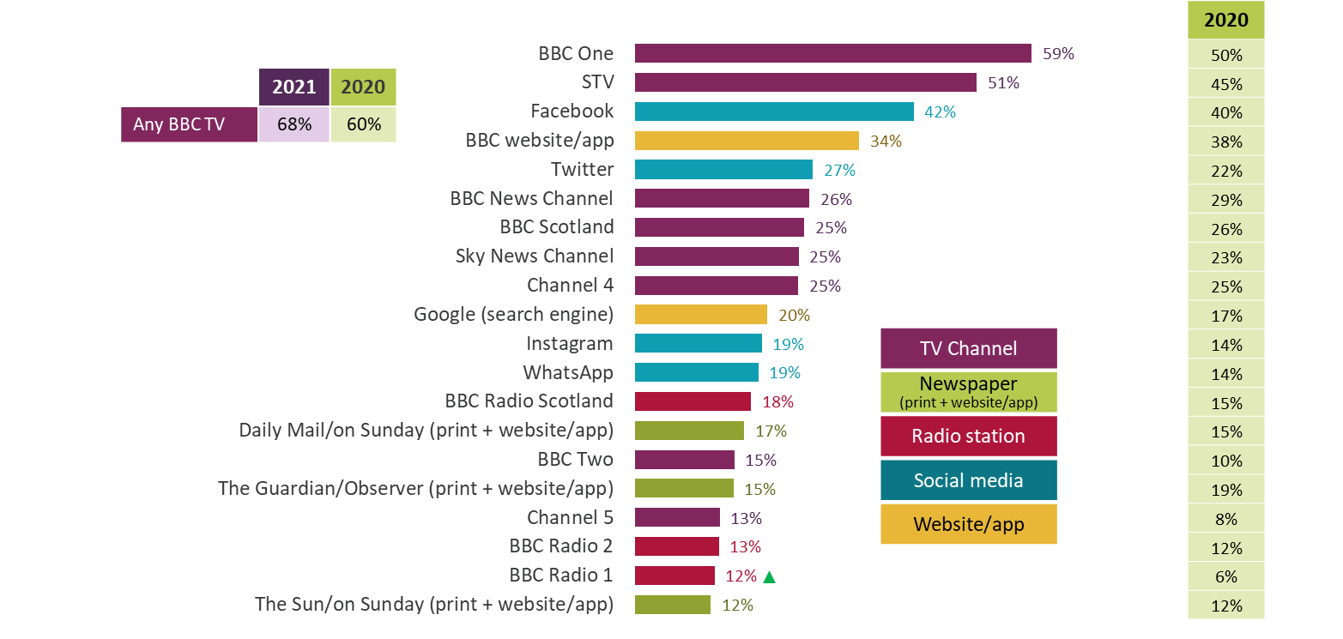
Top 20 sources for news in general - Scotland
% of adults 16+ in Scotland using each source for news nowadays
Three in five adults in Scotland use BBC One, with half using STV
Figure 13.4
Source: Ofcom News Consumption Survey 2021 - ONLINE sample only Green/red triangles indicate statistically significant differences between 2021 and 2020
Question: D2a-D8a. Thinking specifically about <platform>, which of the following do you use for news nowadays?
Base: All adults 16+ in Scotland – 2021=303, 2020=182
2020 and 2021 ONLINE SAMPLE ONLY

Slide 92
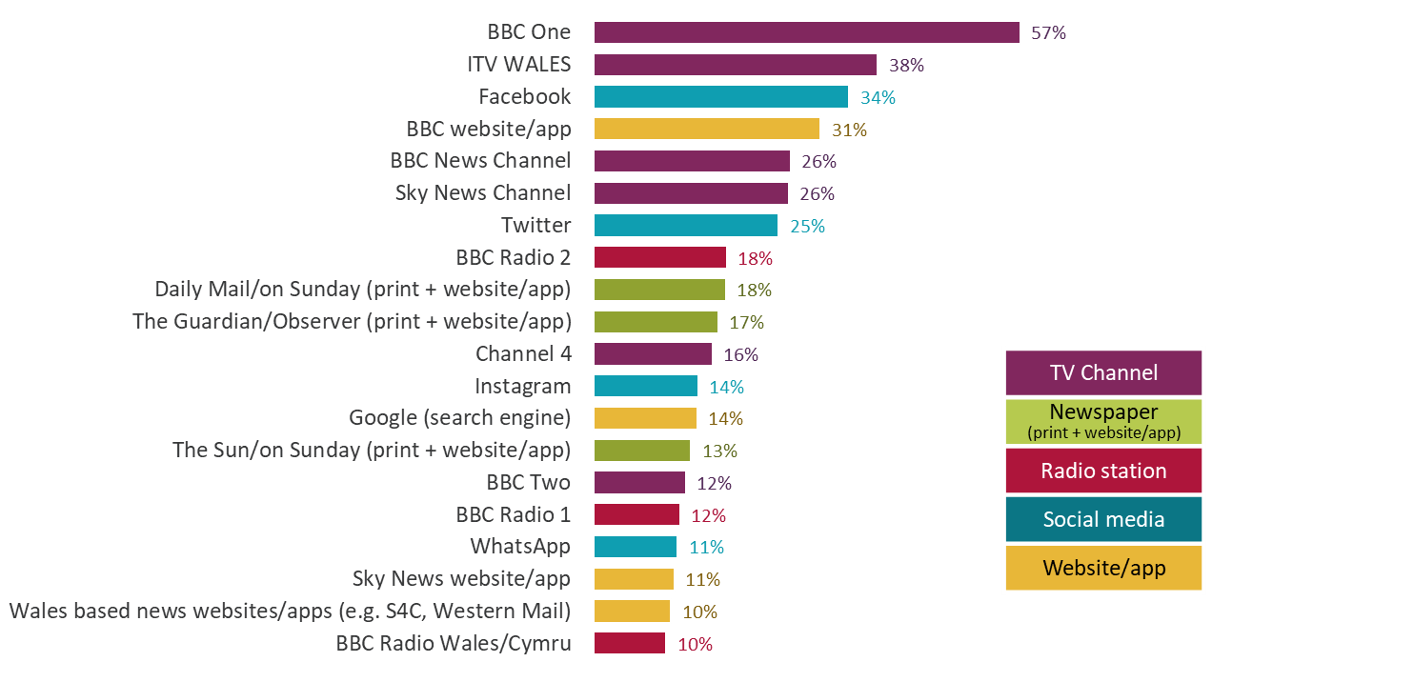
Top 20 sources for news in general - Wales
% of adults 16+ in Wales using each source for news nowadays
Three fifths of adults in Wales use BBC One for news, two fifths use ITV and one third Facebook and/or the BBC website/app
Figure 13.5
Source: Ofcom News Consumption Survey 2021 - ONLINE sample only
Question: D2a-D8a. Thinking specifically about <platform>, which of the following do you use for news nowadays?
Base: All adults 16+ in Wales – 2021=252, 2020=103⁻ ⁻2020 data not shown here as sample size=103
2020 and 2021 ONLINE SAMPLE ONLY

Slide 93
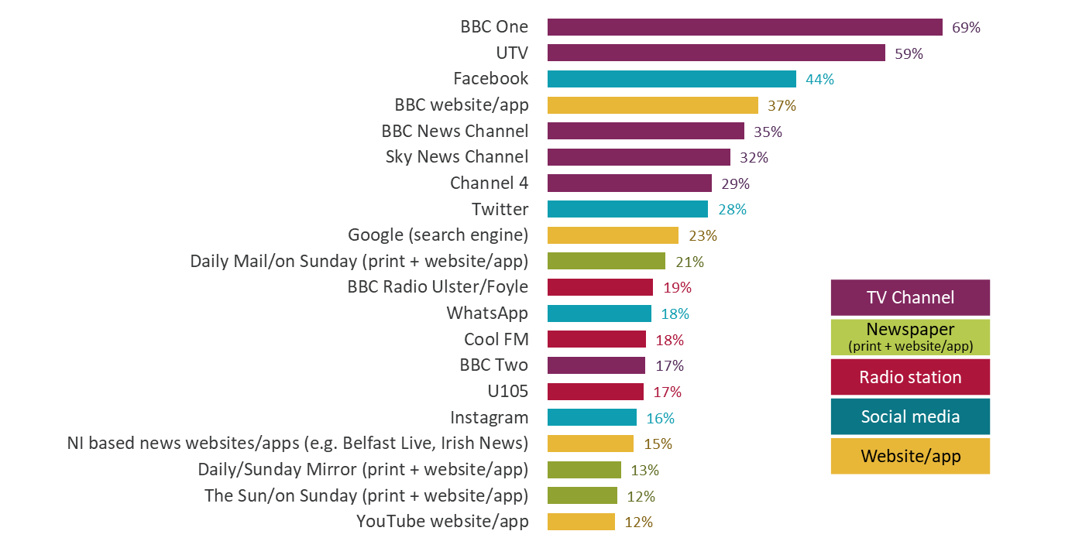
Top 20 sources for news in general - Northern Ireland
% of adults 16+ in Northern Ireland using each source for news nowadays
Two thirds of adults in Northern Ireland claim to use BBC One; three in five use UTV; just over two in five use Facebook; and around one third use BBC website/app, BBC News Channel and Sky News channel
Figure 13.6
Source: Ofcom News Consumption Survey 2021 - ONLINE sample only
Question: D2a-D8a. Thinking specifically about <platform>, which of the following do you use for news nowadays?
Base: All adults 16+ in Northern Ireland – 2021=250, 2020=76 ⁻ ⁻ 2020 data not shown here as sample size=76
2021 ONLINE SAMPLE ONLY

Slide 94
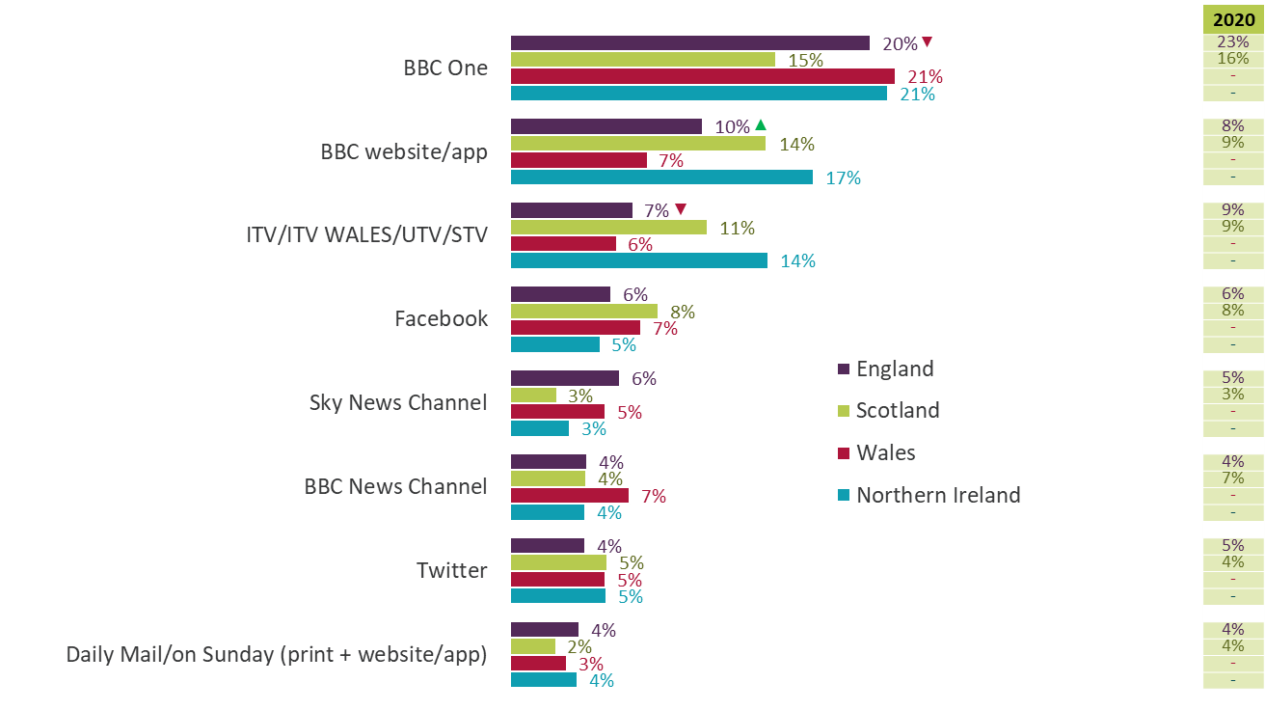
Single most important source for news in general – by Nation
All adults 16+ in each Nation using TV/Newspapers/Radio/Internet/Magazines for news
BBC One is the single most important news source across Wales, England and Northern Ireland, and joint most important with the BBC website/app in Scotland.
Figure 13.7
Source: Ofcom News Consumption Survey 2021 - ONLINE sample only Green/red triangles indicate statistically significant differences between 2021 and 2020
Question: E1a. Looking at all the sources of news you have just said that you use, which one is most important to you?
Base: All adults 16+ using TV/Newspapers/Radio/Internet/Magazines for news 2021/2020 – Eng=2408/2068,
Scot=290/175, Wales=242/100 ⁻, NI=243/74 ⁻ ⁻ 2020 data not shown here as sample size=100/74
Only sources with an incidence of 4%+ in 2021 for the Total sample are shown.
2020 and 2021 ONLINE SAMPLE ONLY

Slide 95
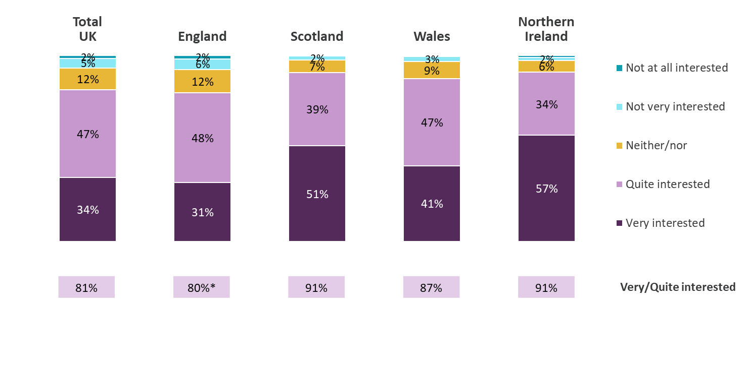
Level of interest in news about own nation 2021 – by Nation
All adults 16+ who follow news
Adults in Northern Ireland and Scotland are the most likely to say they are ‘very interested’ in news about their nation, whereas those in England and Wales are more likely to be ‘quite interested’
Figure 13.8
*‘Very/quite interested’ scores in England are lower than those in Scotland, Wales and NI
Source: Ofcom News Consumption Survey 2021 – COMBINED CATI & ONLINE sample
Question: F3. How interested are you in news about <NATION>?
Base: All adults 16+ who follow news 2021 - Total=4499, England=3046, Scotland=518, Wales=466, Northern Ireland=469
Data not comparable to previous surveys, due to Covid-19 enforced methodological changes

Slide 96
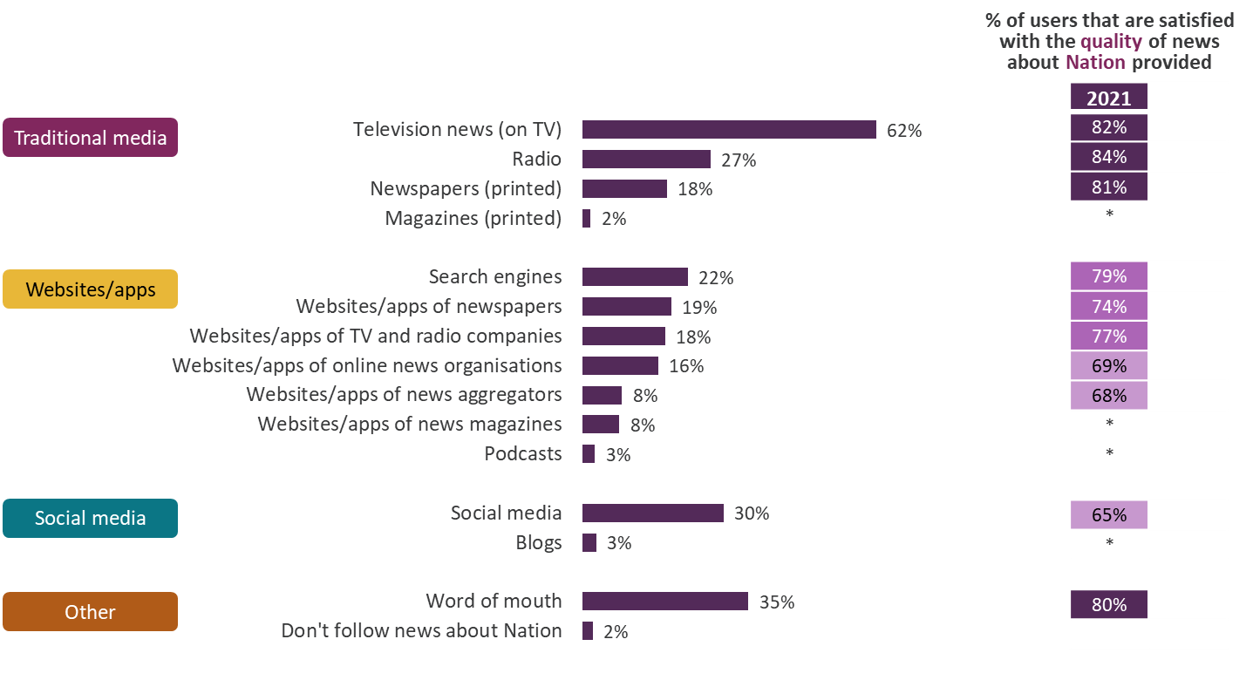
Platforms used to access news about own nation 2021
All in Scotland/Wales/N Ireland who follow news
TV is the most used platform for accessing news about the nations.
Satisfaction with the quality of news is generally higher for the traditional
media channels compared to websites/apps and social media
Figure 13.9
Source: Ofcom News Consumption Survey 2021 – COMBINED CATI & ONLINE sample
Question: F4. Thinking particularly about your source of news for what is going on in NATION, which of the following do you use?
Base: All adults 16+ who follow news in Scotland/Wales/N Ireland – 2021=1453
F5. How satisfied are you with the quality of the news about NATION available from [source]?
Base: All using each source – 2021=123-891 *sample size <100.
Data not comparable to previous surveys, due to Covid-19 enforced methodological changes

Slide 97
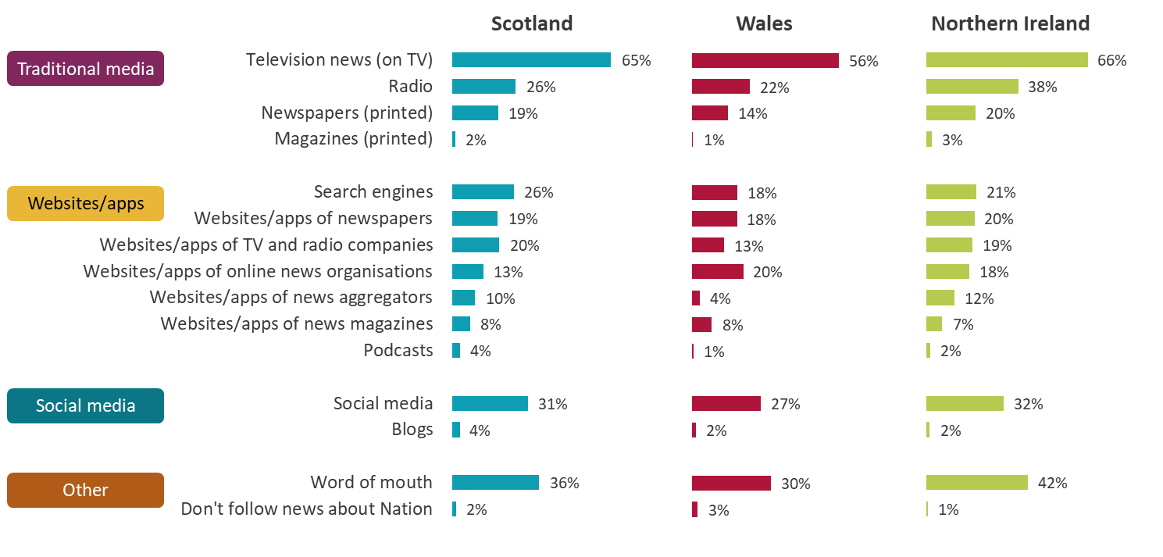
Platforms used to access news about own nation 2021 – by Nation
All in Scotland/Wales/N Ireland who follow news
TV is the most popular platform for accessing news about the nations, although more popular in Northern Ireland and Scotland than in Wales
Figure 13.10
Source: Ofcom News Consumption Survey 2021 – COMBINED CATI & ONLINE sample
Question: F4. Thinking particularly about your source of news for what is going on in NATION, which of the following do you use?
Base: All adults 16+ who follow news – Scotland=518, Wales=466, N Ireland=469
Data not comparable to previous surveys, due to Covid-19 enforced methodological changes

Slide 98
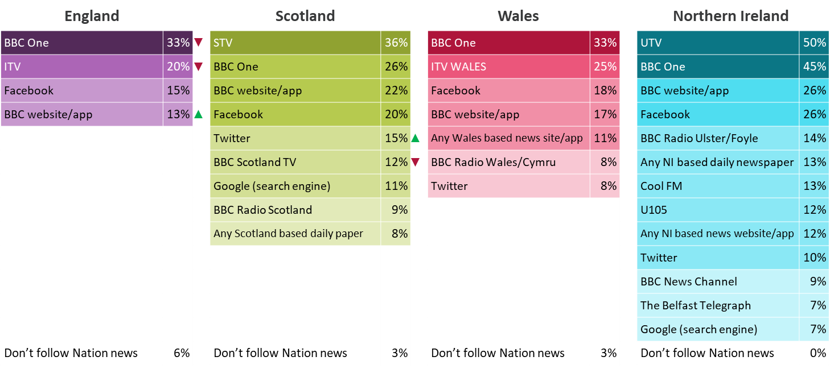
Sources used to access news about own nation
All adults 16+ using TV/Newspapers/Radio/Internet/Magazine for news
BBC One is the most used news source in England and Wales for accessing news about the Nation, whereas STV is most used in Scotland and UTV and BBC One are the most used in Northern Ireland
Figure 13.11
Source: Ofcom News Consumption Survey 2021 – ONLINE sample only Green/red triangles indicate statistically significant differences between 2021 and 2020
Question: F6. From which of the following sources do you get news about what is going on in your NATION nowadays?
Base: All adults 16+ using TV/Newspapers/Radio/Internet/Magazine for news - England=2408, Scotland=290,
Wales=242, Northern Ireland=243 Only sources with an incidence of >6% in each Nation are shown
2020 and 2021 ONLINE SAMPLE ONLY

Slide 99
Current affairs

Slide 100
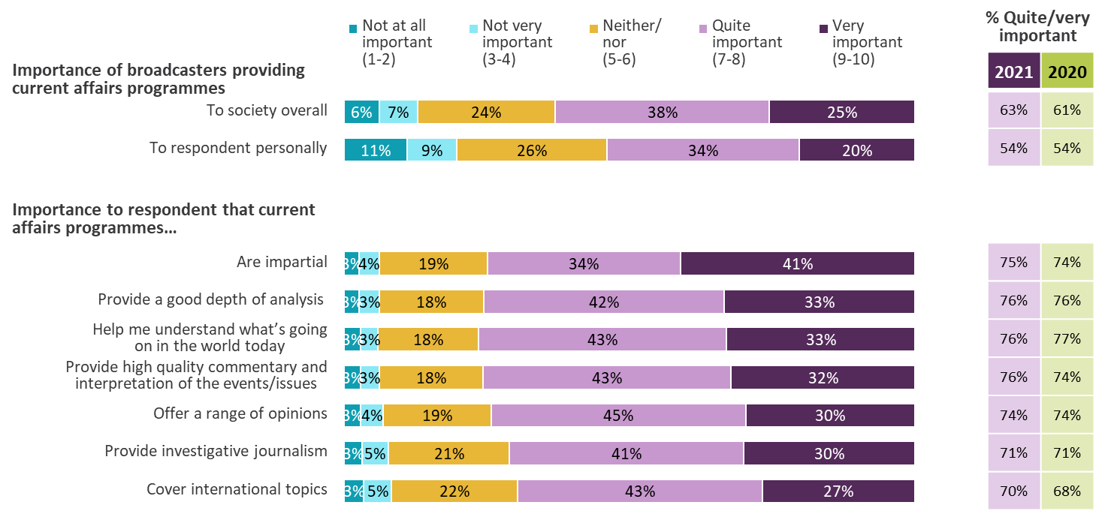
Attitudes to current affairs programmes
All adults 16+
Just over six in ten adults feel it is important ‘to society overall’ that broadcasters provide current affairs programmes, while just over half feel it is important ‘to them personally’
Figure 14.1
Source: Ofcom News Consumption Survey 2021 - ONLINE sample only Green/red triangles indicate statistically significant differences between 2021 and 2020
Question: H1/H2. On a scale of 1 -10 where 1 means not at all important and 10 means extremely important, how important for [you personally / society overall] is it that broadcasters provide current affairs programmes? H3. How important for you personally is it that current
affairs programmes…
Base: All adults 16+ - 2021=3327, 2020=2510
2020 and 2021 ONLINE SAMPLE ONLY

Slide 101
How children aged 12-15 consume news

Slide 102
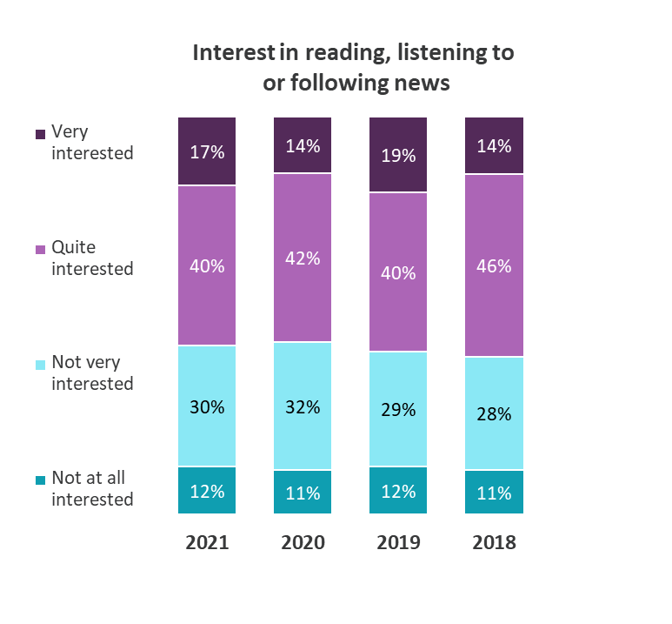
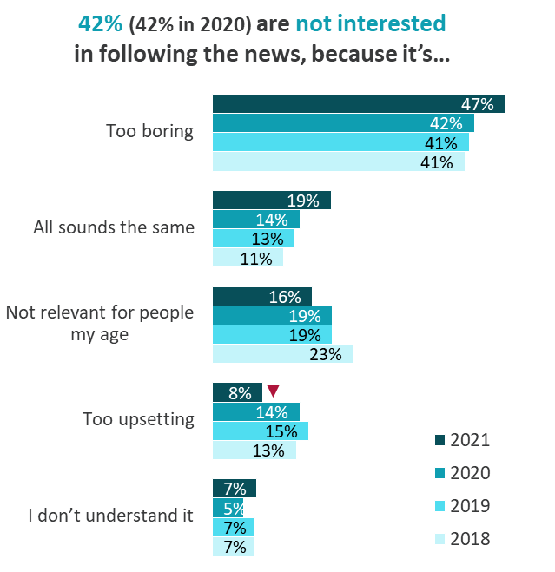
Overall interest in following the news
All children aged 12-15
As in previous years, just under six in ten 12-15s claim to be very or quite interested in following the news. Being ‘too boring’ remains the key reason for a lack of engagement
Figure 15.1
Source: Ofcom Children’s News Consumption Survey 2021
Question: B1. How interested are you in reading, watching, listening to or following news? Base: All children aged 12-15 – 2021=1010, 2020=1007, 2019=1000, 2018=1001
Question: B2. Why are you not interested in reading, watching, listening to or following news? Base: All not interested in following news – 2018-2021=421-395
Green/red triangles indicate statistically significant differences at 95% confidence level between 2021 and 2020

Slide 103
Reasons for following the news
All children aged 12-15
The main reasons for being engaged with the news also remain largely unchanged. 12-15 year olds like to understand what’s going on around them, to learn about new things and to be made to think
Figure 15.2
Source: Ofcom Children's News Consumption Survey 2021
Question: F1. Here are some reasons that young people might have for reading, watching, listening to or following news. Which of these apply to you?
Base: All children aged 12-15 – 2021=1010, 2020=1007, 2019=1000, 2018=1001
Green/red triangles indicate statistically significant differences at 95% confidence level between 2021 and 2020

Slide 104
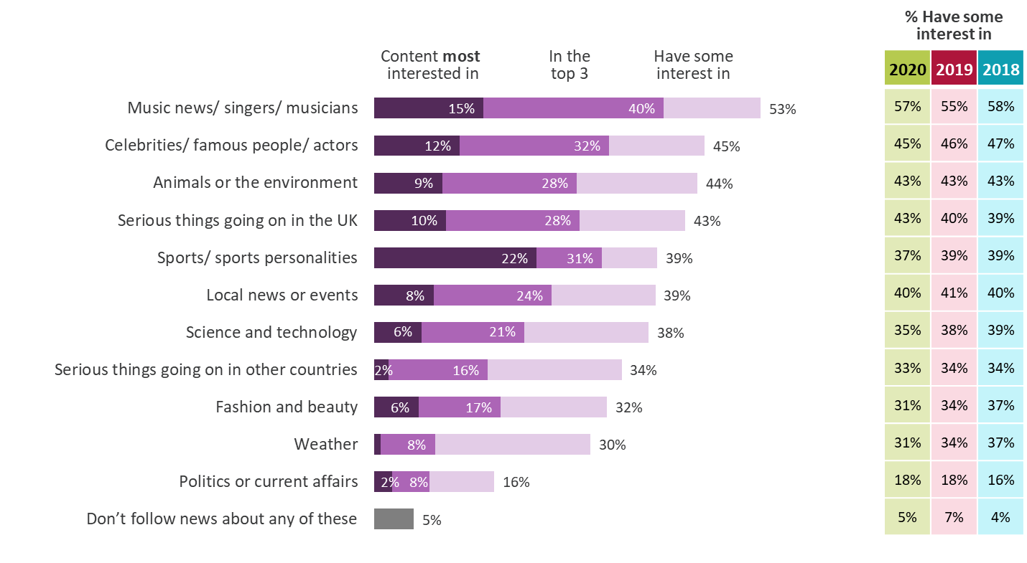
Interest in different types of news content
All children aged 12-15
12-15 year olds remain particularly interested in news about music, followed by news about celebrities, the environment and serious things happening in the UK. However, one in five remain most interested in news about sport.
Figure 15.3
Source: Ofcom Children's News Consumption Survey 2021
Question: B3. Here are some different types of news. Which, if any, of these are you interested in? B4. Which of these types of news are you most interested in?
Base: All children aged 12-15 – 2021=1010, 2020=1007, 2019=1000, 2018=1001
Green/red triangles indicate statistically significant differences at 95% confidence level between 2021 and 2020

Slide 105


Interest in following the news – by child’s gender
All children aged 12-15
Boys are more likely to be very interested in the news than girls. They are more interested in news about sport and science & tech, whereas girls are more interested in music, celebrities, the environment and fashion & beauty
Figure 15.4
Source: Ofcom Children’s News Consumption Survey 2021
Question: B1. How interested are you in reading, watching, listening to or following news? B3. Here are some different types of news. Which, if any, of these are you interested in? Base: All children aged 12-15 2021 – Boys=503, Girls=507
Asterisks indicate statistically significant differences at 95% confidence level between the data for Boys and Girls

Slide 106

Frequency of following the news
All children aged 12-15
As in 2020, three quarters of 12-15s claim to consume news on a weekly basis, five in six say they are inadvertently exposed to news and six in ten actively look for it
Figure 15.5
Source: Ofcom Children's News Consumption Survey 2021 Green/red triangles indicate statistically significant differences at 95% confidence between 2021 and 2020
Question: B5. How often do you read, watch, listen to or follow the news? Base: All children aged 12-15 – 2020=1010, 2020=1007
B6. Sometimes people find out about the news because others are watching, listening to or talking about it. On other occasions they may see a news story online, when they’re lookling for something else. B7. Sometimes people actively look for news. For example, they decide to watch it on TV, listen to it on the radio or read it in the paper. On other occasions, they may go online to look for news, sign up to news alerts or read news updates on social media. How often, if at all do, you actively read, watch, listen to or follow the news like this?

Slide 107

All platforms used for news nowadays
All children aged 12-15
Talking to family and watching TV remain the most common ways to find out about news among 12-15s, followed by social media and talking to friends
Figure 15.6
Girls are more likely than boys to find out about news via social media (49% in top 3 vs 42%) and talking with friends (39% in top 3 vs 30%)
Source: Ofcom Children's News Consumption Survey 2021 Green/red triangles indicate statistically significant differences at 95% confidence between 2021 and 2020
Question: C1. Here is a list of different ways you can find out about or get updates on news stories. Which of these ways do you ever use?
C2. And which of these ways do you use the most to get updates on news stories?
Base: All children aged 12-15 – 2021=1010, 2020=1007, 2019=1000, 2018=1001
*Other websites/apps includes any internet source, excluding social media and search engines, but including podcasts

Slide 108

Platforms/method used most often for different types of news content 2021
All children aged 12-15 who follow each type of news content
As in 2020, Social media is used most often for celebrity, music and fashion news. TV is the most popular platform for all other types of news content
Figure 15.7
Source: Ofcom Children's News Consumption Survey 2021
Question: C3. Where do you tend to go most often for the following types of news stories?
Base: All children aged 12-15 who follow each type of news content (bases shown above)
*Other websites/apps includes any internet source, excluding social media and search engines, but including podcasts

Slide 109

Top 20 news sources
All children aged 12-15
BBC One/Two remain the most used and most important sources of news across all platforms, but there has been a decrease in the usage of BBC One/Two and ITV since 2020. Sky News, TikTok and WhatsApp are all used more for news than in 2020
Figure 15.8
TV Channel
Social media
Radio station
Website/app
Newspaper (print only)*
Girls are more likely than boys to use Instagram (32% vs 25%), TikTok (26% vs 18%) and Snapchat (21% vs 13%)
Boys are more likely than girls to use Sky News (28% vs 21%) and BBC/CBBC websites/apps (12% vs 8%)
Source: Ofcom Children's News Consumption Survey 2021 Green/red triangles indicate statistically significant differences at 95% confidence between 2021 and 2020
Question: D1. Which, if any, of the following do you use to read, watch, listen to or follow news stories?
E1a. Here is a list of all the news sources that you say you use. Which ONE of these is the most important news source to you?
Base: All children aged 12-15 – 2020=1010, 2020=1007, 2019=1000, 2018=1001
*YouTube is a net for YouTube as a ‘social media’ channel plus YouTube website/app as ‘an other website/app’

Slide 110

Number of individual sources named - by platform
All children aged 12-15 using each platform for news
Across all platforms, an average of 4.1 individual sources are used for news. Social media news users use an average of 3.2 social media sources, an increase from 2.6 since 2020
Figure 15.9
Source: Ofcom Children's News Consumption Survey 2021 Green/red triangles indicate statistically significant differences at 95% confidence between 2021 and 2020
Question: D1. Which, if any, of the following do you use to read, watch, listen to or follow news stories?
Base: All using each platform for news 2021 – All platforms=1010, TV=658, Social media=574, Radio=348, Other websites/apps=214, Newspapers=163, All internet (Social media and/or Other websites/apps)=632 *Other websites/apps includes any internet source, excluding social media and search engines
Note: Some respondents did not name specific sources within a platform so appear as having zero sources

Slide 111


57% of 12-15s claim to access news via social media. They are most likely to access news via trending news, comments and links posted by friends/family. The most common actions include clicking on stories and looking at comments
Figure 15.10
Source: Ofcom Children's News Consumption Survey 2021 Green/red triangles indicate statistically significant differences at 95% confidence between 2021 and 2020
Question: C7. Which, if any, of the following do you read or see on the social media sites or apps you use most often?
Base: All using social media to follow news – 2021=574, 2020=555, 2019=548, 2018=556
C8. Which, if any, of the following do you do when you read or see [type of news] on social media sites or apps?
Base: All accessing news from each source via social media 2021/2020 – Trending news=318/292, News stories from friends/family/other people=410/395, News organisations=310/288 Note: Columns do not sum to 100% (this was a multi-code question)

Slide 112

Initial introduction to news sources 2021
All children aged 12-15 using each source for news
When 12-15s were asked how they first found out about particular news sources, friends are typically mentioned for social media, whereas parents are mostly cited in relation to more traditional media
Figure 15.11
Source: Ofcom Children's News Consumption Survey 2021
Question: D3. How did you first find out about SOURCE as a source of news?
Base: All children aged 12-15 who use each source for news (bases shown above, only sources used by 100+ respondents included)

Slide 113

Attributes of news platforms - 2021
Ratings from children aged 12-15 using each platform for news
Users of TV and Newspapers tend to give high ratings across the majority of the attributes. By comparison, social media users give comparatively lower scores, especially for ‘trustworthy’ and ‘accuracy’
Figure 15.12
Source: Ofcom Children's News Consumption Survey 2021 Green/red triangles indicate statistically significant differences at 95% confidence between 2021 and 2020
Question: E2. You will now see all of the other news sources that you use. I would like you to tell me how important each one is to you.
E3. You will now see a list of statements. I would like you to tell me how often each of these statement applies to each of the different news sources
Base: All ratings by children aged 12-15 who use each platform for news – TV=1076, Newspapers=356, Radio=536, Social media=1821, Other websites/apps=326

Slide 114

Attributes of news sources – 2021
All children aged 12-15 using each source for news
BBC/CBBC website/app, BBC Radio 1/Newsbeat, BBC One/Two, Sky News and ITV tend to receive the highest ratings (above 80%) from their users across most of the attributes
Figure 15.13
Source: Ofcom Children's News Consumption Survey 2021
Question: E2. You will now see all of the other news sources that you use. I would like you to tell me how important each one is to you
E3. You will now see a list of statements. I would like you to tell me how often each of these statement applies to each of the different news sources
Base: All children aged 12-15 who use each source for news (bases shown above, only sources used by 100+ respondents included)

Slide 115

Perceived accuracy of news stories from each platform
All children aged 12-15 who use each platform for news
Family, radio, podcasts and TV are to be considered the most accurate/truthful sources, while social media and friends are the considered least truthful
Figure 15.14
Source: Ofcom Children's News Consumption Survey 2021
Question: C4. Which one of these answers best describes the news that you read or see?
C5/6. When you hear about news stories from your [friends / family], how likely do you think the stories are to be accurate?
Base: All children aged 12-15 who use each platform for news (bases shown above)
Green/red triangles indicate statistically significant differences at 95% confidence level between 2021 and 2020

Slide 116


Accuracy of news stories accessed via social media (1)
All children aged 12-15 who use social media for news
Two in five 12-15 year olds who use social media for news claim they always/ often think about whether stories are reported accurately. More than half said it was difficult to tell whether the news on social media is accurate
Figure 15.15
Boys are more likely than girls to say it is ‘easy’ to tell that a news story on social media is accurate
(24% very /quite easy vs. 15%)
Source: Ofcom Children's News Consumption Survey 2021
Question: C9a. When you read or see a news story on social media sites or apps, how often, if at all do you think about whether the story is actually true?
C10. How easy or difficult is it to tell whether a news story on social media is true?
Base: All using social media to follow news – 2021=574, 2020=555, 2019=548, 2018=556
Green/red triangles indicate statistically significant differences at 95% confidence level between 2021 and 2020

Slide 117



Accuracy of news stories accessed via social media (2)
All children aged 12-15 who use social media for news
Social media news users aged 12-15 were asked what they would do if they wanted to check a news story they had seen. As in 2020, the most common actions were to ‘look at the comments about the story’ and to ‘check if the same story appears anywhere else’
Figure 15.16
Perceptions of news stories on social media
Actions might take to check authenticity of an SM news story
34% (33% in 2020) think that news stories on social media are reported truthfully most or all of the time
42% (41% in 2020) will normally think about whether a news story they see on social media is actually true
19% (17% in 2020) find it easy to tell whether a news story on social media is true
Source: Ofcom Children's News Consumption Survey 2021 Green/red triangles indicate statistically significant differences at 95% confidence between 2021 and 2020
Question: C4. Which one of these answers best describes the news that you read or see? C9a. When you read or see a news story on social media sites or apps, how often,
if at all do you think about whether the story is actually true? C10. How easy or difficult is it to tell whether a news story on social media is true?
C11. When you read or see a news story on social media sites or apps which if any of these things would you ever do if you wanted to check the story?
Base: All using social media to follow news – 2021=574, 2020=555

Slide 118
Accuracy of news stories accessed online
All children aged 12-15
Two in five 12-15 year olds have seen a deliberately untrue or misleading news story online in the last year. Upon seeing such a story, the most likely actions include telling parents or other family members or friends.
Figure 15.17
Actions might take if saw a deliberately
untrue/ misleading news story online
Incidence of seeing a deliberately untrue/ misleading news story online in the last 12 months
Boys are more likely than girls to say they’ve seen a deliberately untrue/ misleading news story (44% vs. 37%)
Source: Ofcom Children's News Consumption Survey 2021 Green/red triangles indicate statistically significant differences at 95% confidence between 2021 and 2020
Question: C14. In the last 12 months, have you ever seen anything online or on social media that you thought was a deliberately untrue/misleading news story?
C15. If you did see a news story on social media or online that you thought was deliberately untrue/misleading what, if anything would you do about it?
Base: All children aged 12-15 – 2021=1010

Slide 119
Appendix – Industry currencies and methodology

Slide 120
Industry currencies used in the report
BARB (Broadcasters’ Audience Research Board) is the official industry currency for TV consumption. It uses a continuous panel of approximately 5,300 UK homes and tracks television viewing among all people aged 4+ in these homes using meters attached to every working television set in the home.

Slide 121
News Consumption Survey – Adult methodology
From December 2017 until March 2020, Jigsaw Research conducted a mixed methodology approach, combining online and face to face interviews. However, during the most recent period of research, they were unable to conduct face to face interviews, due to the Covid-19 pandemic.
Since online methodologies tend to underrepresent low/non internet users, Jigsaw conducted separate Computer Assisted Telephone Interviewing (CATI) to ensure that these groups had the opportunity to express their views.
  This additional CATI survey achieved 1,278 interviews, with the nations over-represented during fieldwork.
  This data has been weighted to correct for this over-representation, with weights being applied by age, gender and socio-economic group (SEG) within Nation, to provide a representative view of all UK adults.
In addition to the CATI interviews, a total of 3,327 online panel interviews were undertaken.
  This online data has been weighted by age, gender, nation/region, working status and ethnicity to ensure they are representative of ‘recent’ internet users, as found in the ONS Internet Users research (published on 6th April, 2020).
Due to differences in the questionnaire and differences in how respondents answered questions about individual news sources between the two survey methods used, the combined adult methodology slides only show platform level data. All other adults’ slides are based on the online sample only.
The CATI and online interviews were conducted over two waves of research, from 2nd November – 10th December, 2020 and 27th February – 29th March, 2021. These interviewing periods have remained consistent over the last four years. Consequently, 2020 data was collected pre- Covid-19 and 2021 data was collected during the second and third UK lockdown periods.
  NB: The 2020/21 online data has been reported as ‘2021’ within this report, whilst the 2019/20 online data has been reported as ‘2020’
Findings by different demographic groups are shown on the slides, where possible. Statistically significant differences are shown at a 95% confidence level.

Slide 122
News Consumption Survey – Adult & Child methodology
The survey has approximately 200 codes for different potential sources for news, as well as the option to allow respondents to nominate their own sources which yields a further 800 or so, including regional sources. This gives us a bottom-up measure of what people consider they use for news (about their Nation, the UK, and internationally) and will not necessarily include every possible outlet. The survey therefore provides a granular range of news sources. These individual news sources are then aggregated into various groups or “nets” relating to their owner or publisher.
This is a recall-based survey. As such, it is likely to provide somewhat different results to other types of measurement. In particular, it may underestimate some online news consumption activity. It is likely to be harder for respondents to recall ad-hoc online news consumption compared to, say, the purchase of a newspaper or the watching of an evening television bulletin. On the other hand, respondents show through such surveys which news sources resonate with them.
The methodology used for the 12-15s study is largely unchanged since the 2020, 2019 and 2018 reports.
In total, 503 interviews from 24th November – 7th December 2020 have been combined with 507 interviews from 27th Feb – 24th March 2021. Consequently, 2021 data was collected during the second and third UK lockdown periods.
Quotas were set on age, gender, socio-economic group (SEG) and Nation to ensure the sample was representative of the UK and the data has also been weighted on age, gender, SEG and nation. Statistically significant differences year-on-year are shown at a 95% confidence level.
Each wave of fieldwork was undertaken in three stages:
    Stage 1: We targeted parents of 12-15 year olds, using an online panel.
    Stage 2: Parents were screened to ensure we recruited a representative sample of participants.
    Stage 3: The parent asked their (qualifying) child to complete the rest of the questionnaire.

