Slide 1
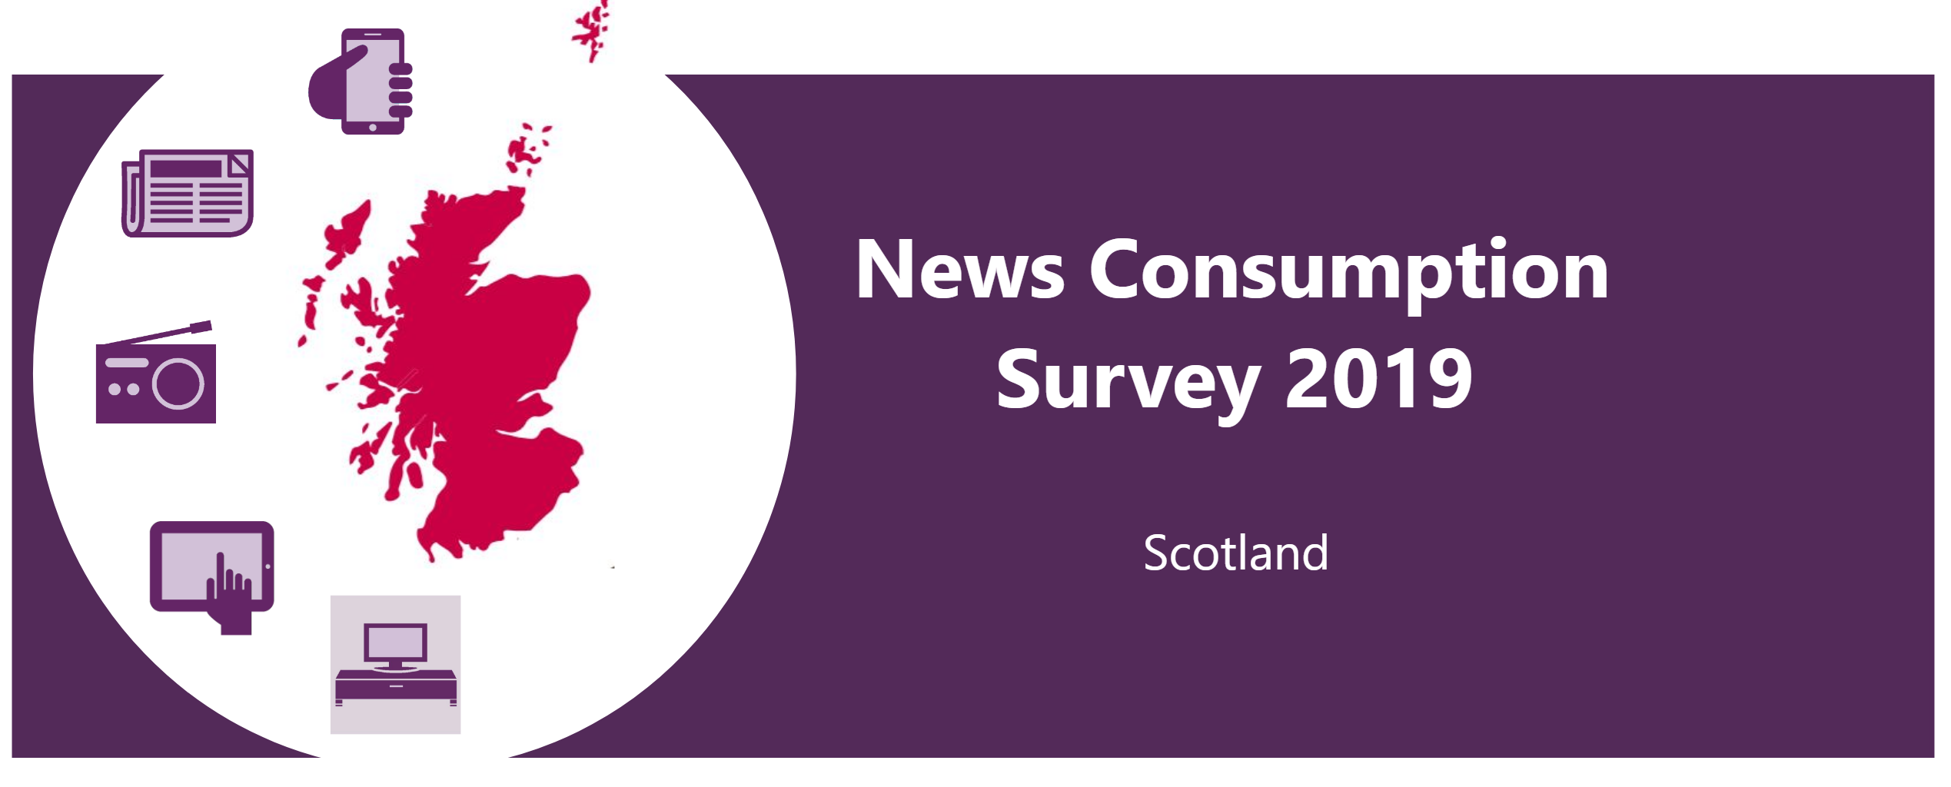


News Consumption
Survey 2021
Northern Ireland

Slide 2
About the News Consumption report 2021
Due to Covid-19 enforced methodological changes, the data in this report is not comparable to data in the previous News Consumption Survey Scotland reports.
The aim of the News Consumption report is to inform understanding of news consumption across the UK and within each UK nation. This includes sources and platforms used, the perceived importance of different outlets for news, attitudes towards individual news sources and local news use.​
The primary source* is Ofcom’s News Consumption Survey. This year, due to Covid-19 fieldwork restrictions, it was not possible to conduct face to face interviews as normal. Therefore, CATI interviews were used in addition to the normal online interviews in order to represent the no/low internet users. In total, 1,278 CATI and 3,327 online interviews across the UK were carried out during 2020/21. The interviews were conducted over two waves (November & December and February & March) in order to achieve a robust and representative view of UK adults.​
Due to differences in the questionnaire and differences in how respondents answered questions about individual news sources between the two survey methods used, only platform level data is available by the combined methodology adult sample. All other adults’ slides are based on the online sample only.
The combined CATI/ONLINE sample size for all adults over the age of 16 in Northern Ireland is 475.​ The ONLINE sample size for all adults over the age of 16 in Northern Ireland is 250.​
The full UK report and details of its methodology can be read here. ​
​*The News Consumption 2021 report also contains information from BARB for television viewing.

Slide 3
Key findings from the 2021 report
TV remains the most-used platform for news nowadays by adults in Northern Ireland at 78%. Social media (55%) and radio (51%) are the next most used platforms for news.
BBC One (69%) and UTV (59%) are both used by over half of adults in Northern Ireland for news. Facebook is the third most popular source at 44%.
‘NI based news websites/apps (e.g. Belfast Live, Irish News)’ are used by 15% of adults in Northern Ireland.
12% use TV channels from the Republic of Ireland (RTE Channels / TV3 / TG4).
Local newspapers are popular; when looking at print/website/app figures combined, 16% of adults in Northern Ireland use the Belfast Telegraph, 8% use the Irish News and a further 4% use the News Letter.
The three most popular radio stations in Northern Ireland are all local; BBC Radio Ulster/Foyle (19%), Cool FM (18%) and U105 (17%).
UTV and BBC One are the most-used sources for accessing news about Northern Ireland by people in Northern Ireland.
Nine in ten people in Northern Ireland who follow news are interested in news about their own nation, which is higher than the UK as a whole.

Slide 4
Top 20 news sources used in Northern Ireland*
% of adults in Northern Ireland using each source for news nowadays
TV Channel | 78%
Newspaper (print) | 29%
Radio station | 51%
Social media | 55%
Other website/app | 46%
Average number of sources used:
9.7 (UK=8.8)
Source: Ofcom News Consumption Survey 2021 – Combined CATI and ONLINE sample
Question: Which of the following platforms do you use for news nowadays?
Base: All adults 16+ in Northern Ireland, 2021=475
Source: Ofcom News Consumption Survey 2021 – ONLINE sample only
Question: D2a-D8a. Thinking specifically about <platform>, which of the following do you use for news nowadays?
Base: All adults 16+ in Northern Ireland – 2021=250. 2020 data not shown here as sample size < 100
*This chart does not include individual title responses from nations ‘write-in’ codes

Slide 5
TV channels used for news nowadays - Northern Ireland
Source: Ofcom News Consumption Survey 2021 – ONLINE sample only
Question: <D2a> Thinking specifically about television, which of the following do you use for news nowadays?
Base: All adults 16+ in Northern Ireland (250). Any source with lower than 3% excluded from the chart.

Slide 6
Social media sources used for news nowadays - Northern Ireland
Source: Ofcom News Consumption Survey 2021 – ONLINE sample only
Question: <D7a> Thinking specifically about social media (on any device), which of the following do you use to access news nowadays?
Base: All adults 16+ in Northern Ireland (250). Any source with lower than 2% excluded from the chart.

Slide 7
Other internet sources used for news nowadays - Northern Ireland
Source: Ofcom News Consumption Survey 2021 – ONLINE sample only
Question: <D8a> Thinking specifically about other internet sources (including apps), on any device, which of the following do you use for news nowadays?
Base: All adults 16+ in Northern Ireland (250). Any source with lower than 2% excluded from the chart.

Slide 8
Daily newspapers (print) used for news nowadays - Northern Ireland
Source: Ofcom News Consumption Survey 2021 – ONLINE sample only
Question: <D3a> Thinking specifically about daily newspaper(s), which of the following do you use for news nowadays?
Base: All adults 16+ in Northern Ireland (250). Any source with lower than 2% excluded from the chart.

Slide 9
Print and online newspapers used for news nowadays - Northern Ireland
Combined daily and Sunday newspapers/websites and apps*
Source: Ofcom News Consumption Survey 2021 – ONLINE sample only
Question: <D3a> Thinking specifically about daily newspaper(s), which of the following do you use for news nowadays?
<D4a> Thinking specifically about weekly newspaper(s), which of the following do you use for news nowadays?
<D8a> Thinking specifically about other internet sources (including apps) which of the following do you use for news nowadays?
Base: All adults 16+ in Northern Ireland (250). Any source with lower than 2% excluded from the chart.
*This chart includes individual title responses from nations ‘write-in’ codes

Slide 10
Radio sources used for news nowadays - Northern Ireland
Source: Ofcom News Consumption Survey 2021 – ONLINE sample only
Question: <D6a> Thinking specifically about radio, which of the following do you use for news nowadays?
Base: All adults 16+ in Northern Ireland (250). Any source with lower than 2% excluded from the chart.

Slide 11
Level of interest in news about own nation, by nation
All adults 16+ who follow news
81% |  | 80% |  | 91% |  | 87% |  | 91% | Very/Quite interested
Source: Ofcom News Consumption Survey 2021 – COMBINED CATI & ONLINE sample
Question: F3. How interested are you in news about <NATION>?
Base: All adults 16+ who follow news 2021 - Total=4499, England=3046, Scotland=518, Wales=466, Northern Ireland=469

Slide 12
Sources used to access news about own nation
England
Scotland
Wales
Northern Ireland
BBC One | 33% |  | STV | 36% |  | BBC One | 33% |  | UTV | 50%
ITV | 20% |  | BBC One | 26% |  | ITV WALES | 25% |  | BBC One | 45%
Facebook | 15% |  | BBC website/app | 22% |  | Facebook | 18% |  | BBC website/app | 26%
BBC website/app | 13% |  | Facebook | 20% |  | BBC website/app | 17% |  | Facebook | 26%
 |  |  | Twitter | 15% |  | Any Wales based news site/app | 11% |  | BBC Radio Ulster/Foyle | 14%
 |  |  | BBC Scotland TV | 12% |  | BBC Radio Wales/Cymru | 8% |  | Any NI based daily newspaper | 13%
 |  |  | Google (search engine) | 11% |  | Twitter | 8% |  | Cool FM | 13%
 |  |  | BBC Radio Scotland | 9% |  |  |  |  | U105 | 12%
 |  |  | Any Scotland based daily paper | 8% |  |  |  |  | Any NI based news website/app | 12%
 |  |  |  |  |  |  |  |  | Twitter | 10%
 |  |  |  |  |  |  |  |  | BBC News Channel | 9%
 |  |  |  |  |  |  |  |  | The Belfast Telegraph | 7%
 |  |  |  |  |  |  |  |  | Google (search engine) | 7%
Don’t follow Nation news | 6% |  | Don’t follow Nation news | 3% |  | Don’t follow Nation news | 3% |  | Don’t follow Nation news | 0%
Source: Ofcom News Consumption Survey 2021 – ONLINE sample only
Question: F6. From which of the following sources do you get news about what is going on in your NATION nowadays?
Base: All adults 16+ using TV/Newspapers/Radio/Internet/Magazine for news - England=2408, Scotland=290, Wales=242, Northern Ireland=243. Only sources with an incidence of >6% in each Nation are shown. Green/red triangles indicate statistically significant differences between 2021 and 2020 online samples

